Slide 1

What Maths looks like in Reception at Glebe

Slide 2
Early Years Curriculum - Number
Number and place value | Addition and Subtraction | Sharing | Doubling and halving
-Representation of numbers as value -Need to reliably count and order numbers to 20 -Need to be able to say numbers before or after each -1st, 2nd, 3rd | -Need to be able to work out 1 less, 1 more than any given number -Need to be able to add or subtract 2 digit numbers | -Need to be able to solve problems around sharing | -Need to be able to solve problems around doubling and halving.
Number
Additional to prepare for Year 1 – count in 2s, 5s and 10s

Slide 3
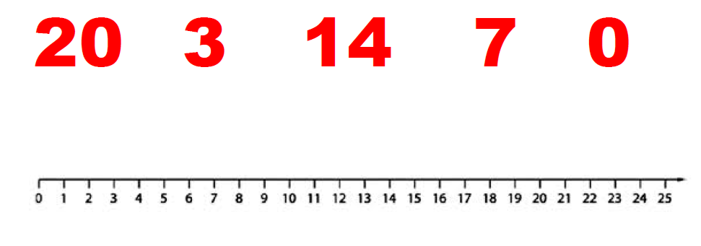
Ordering numbers
Order these numbers from smallest to largest:

Slide 4
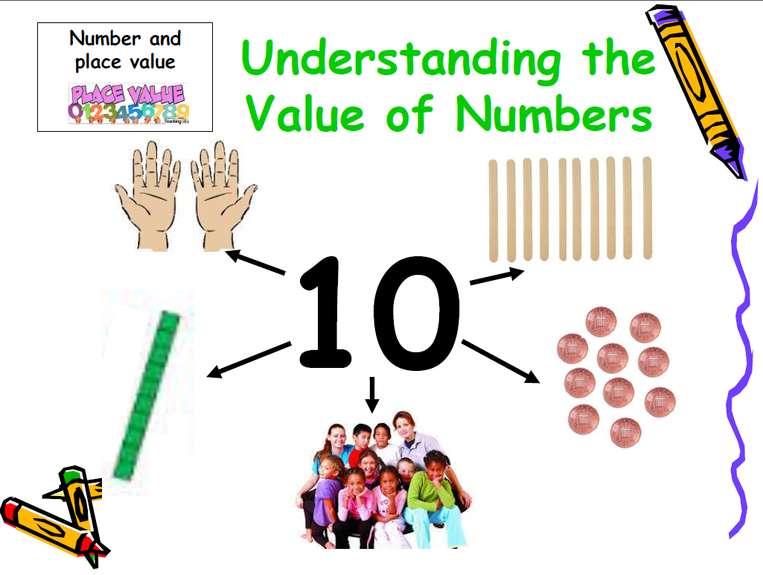
Understanding the Value of numbers

Slide 5
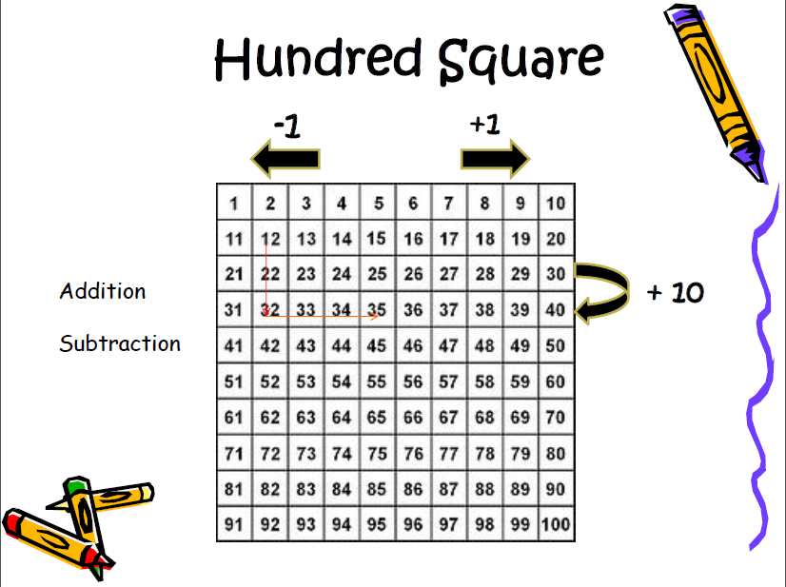

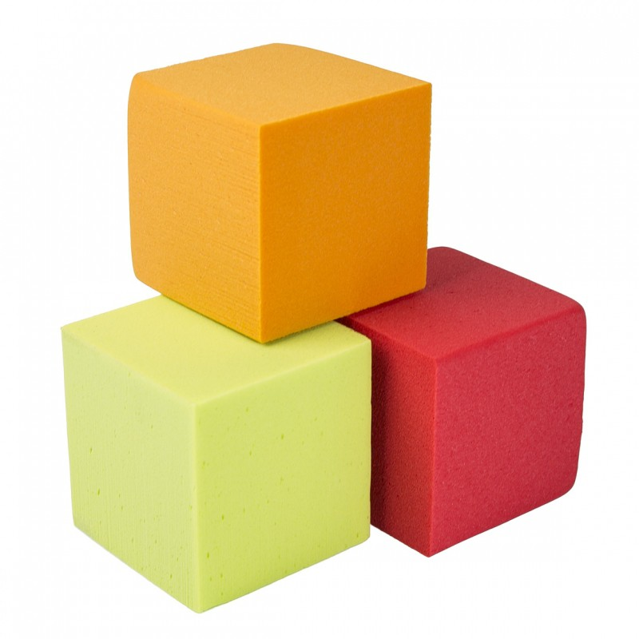
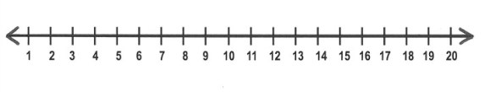
Useful resources for addition and subtraction
Objects
Number line

Slide 6
One more and one less
Objects
What is one more than 10?
What is one less that 5?

Slide 7
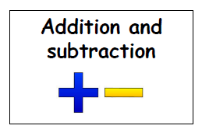
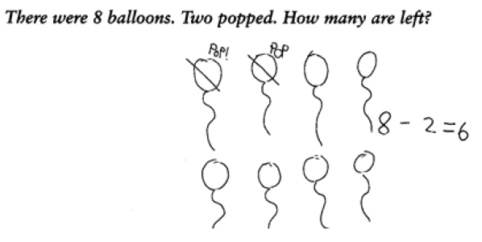
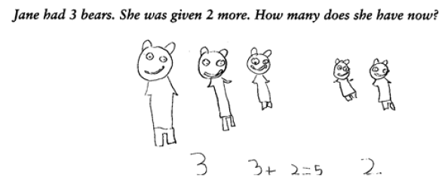
Addition and Subtraction

Slide 8
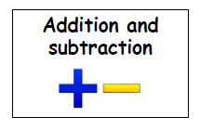
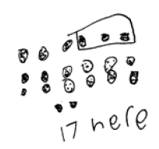
Same problem, different method
20 – 3 = 17

Slide 9
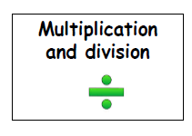
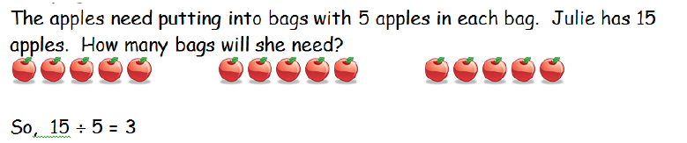
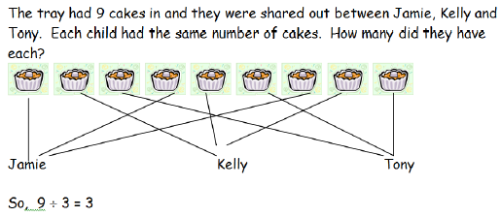
Early stages of division
Grouping
Sharing

Slide 10
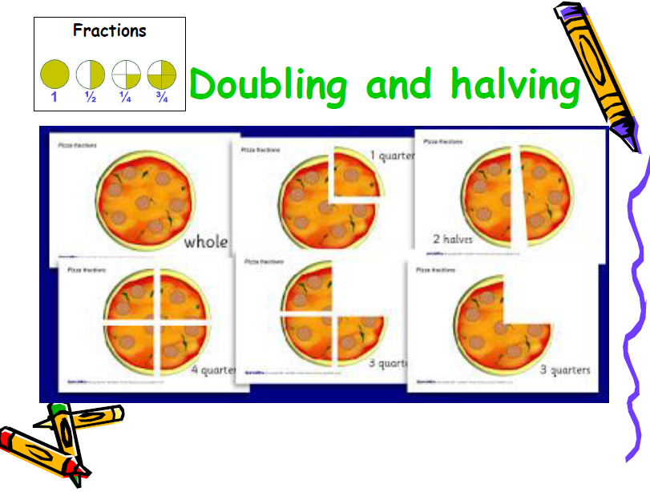
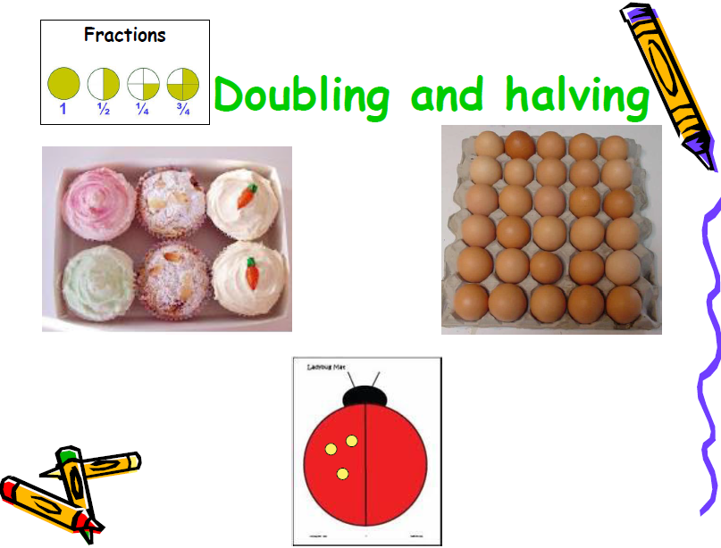
Doubling and halving
5 + 5 = 10
+
Sharing between two

Slide 11
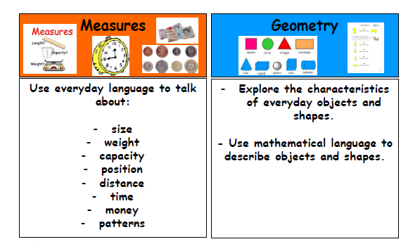
Early years curriculum – Shape, Space and Measure

Slide 12
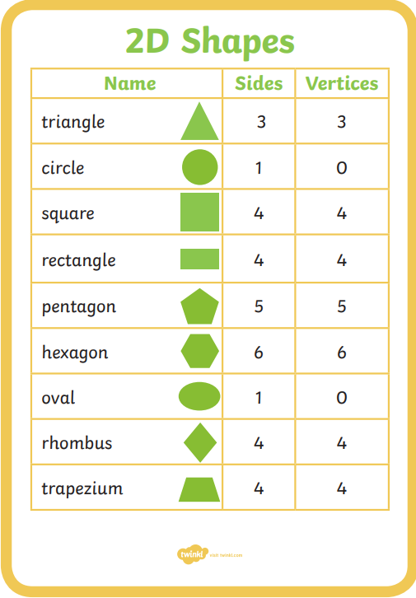
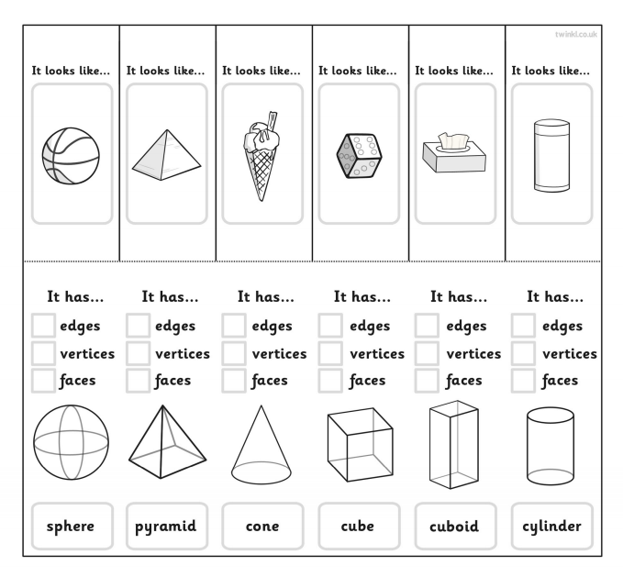
Shapes – 2D and 3D shapes
Children need to be able to identify these different properties of a 3D shape:
Name of the shape.
How many edges.
How many vertices (corners).
How many faces.
Children need to be able to identify these different properties of a 2D shape:
Name of the shape.
How many sides.
How many vertices (corners).

Slide 13
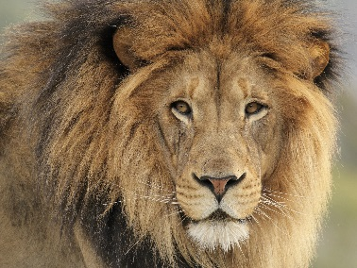

Repeated patterns
Patterns using colours:
Patterns using shapes:
Patterns using pictures:

Slide 14
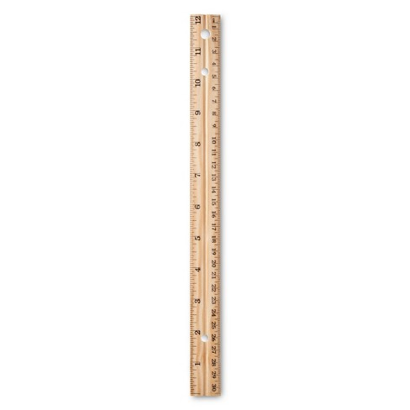
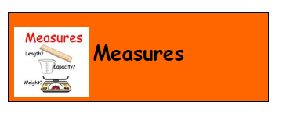

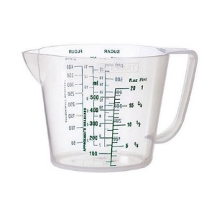

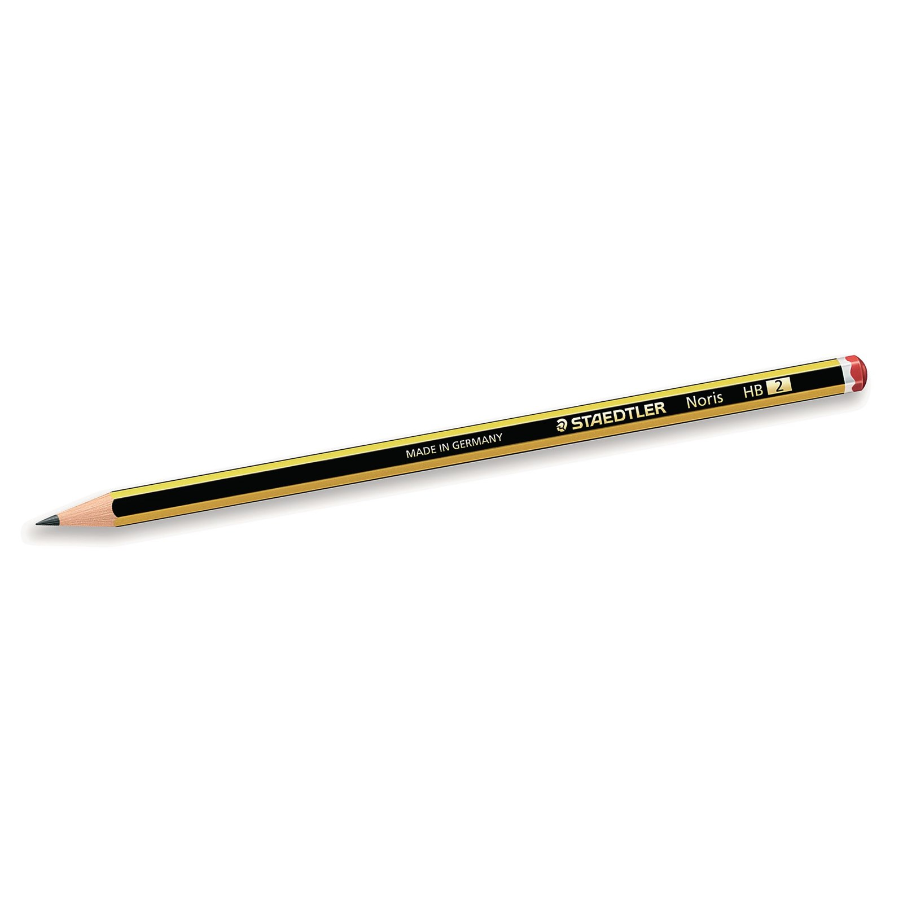
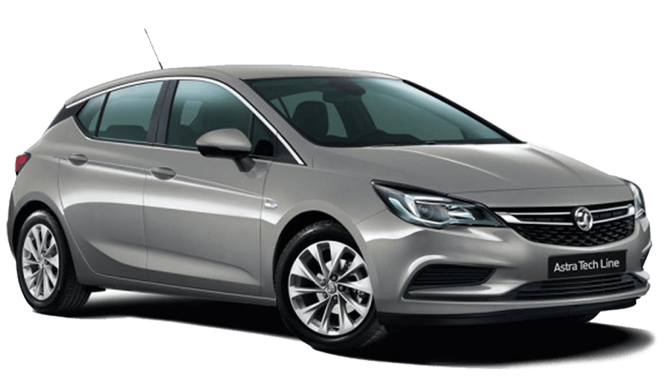

Measures
Length
Capacity
Weight
Height

Slide 15
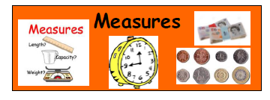
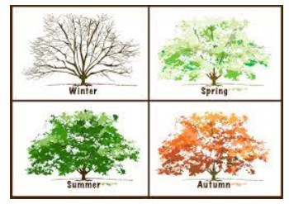



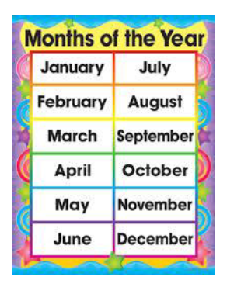
Measures – time
O’clock
Half past
Tomorrow
Today
Yesterday

Slide 16
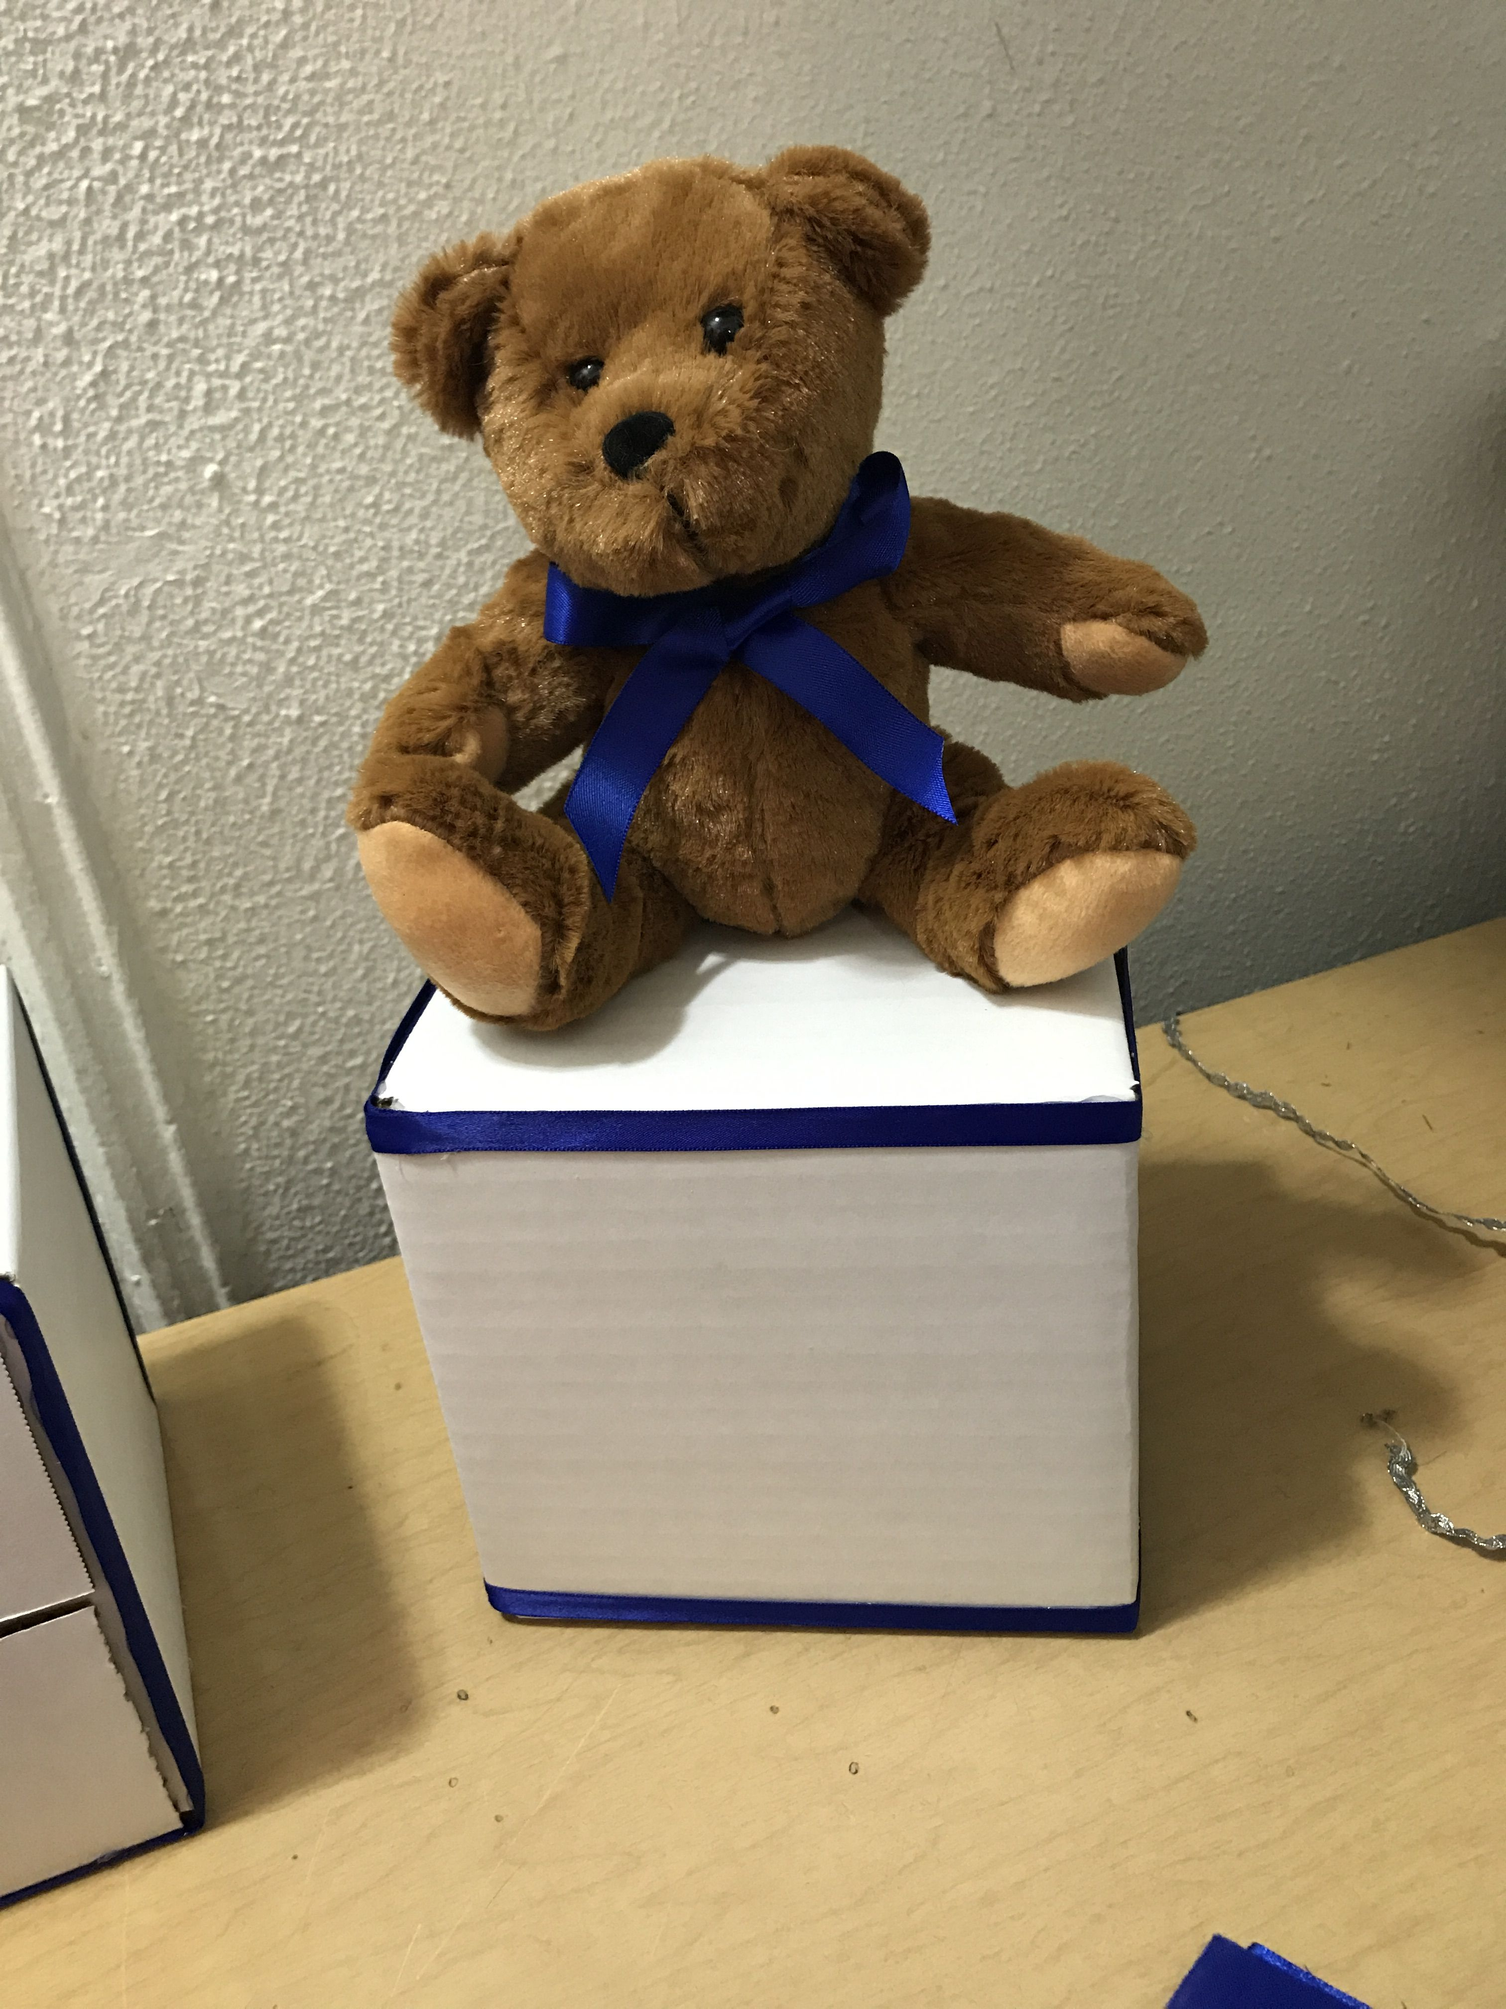
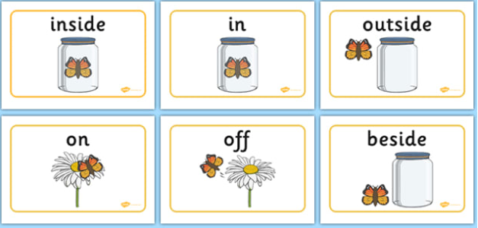
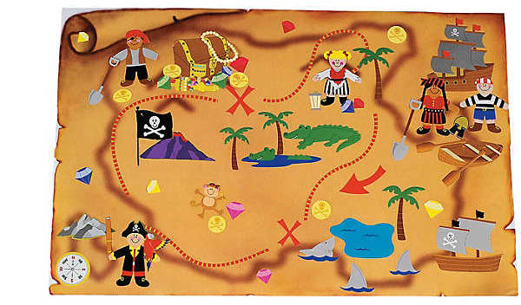
Positional language

Slide 17

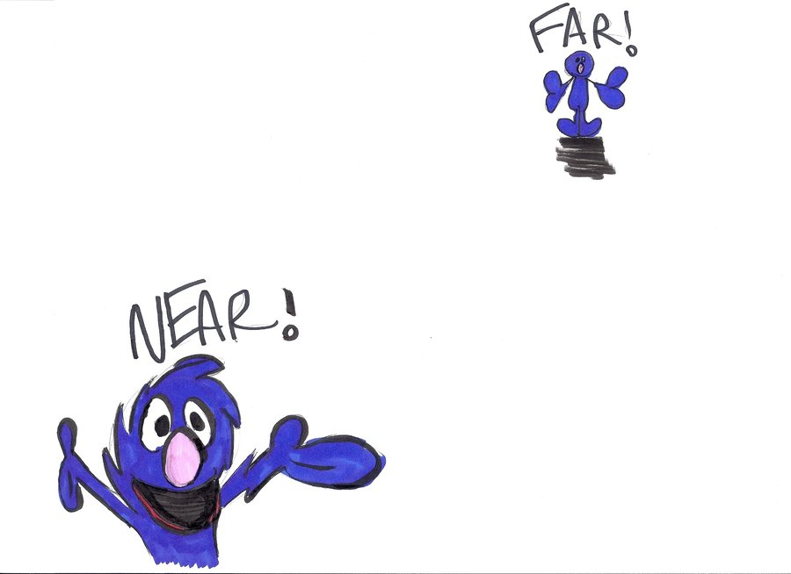

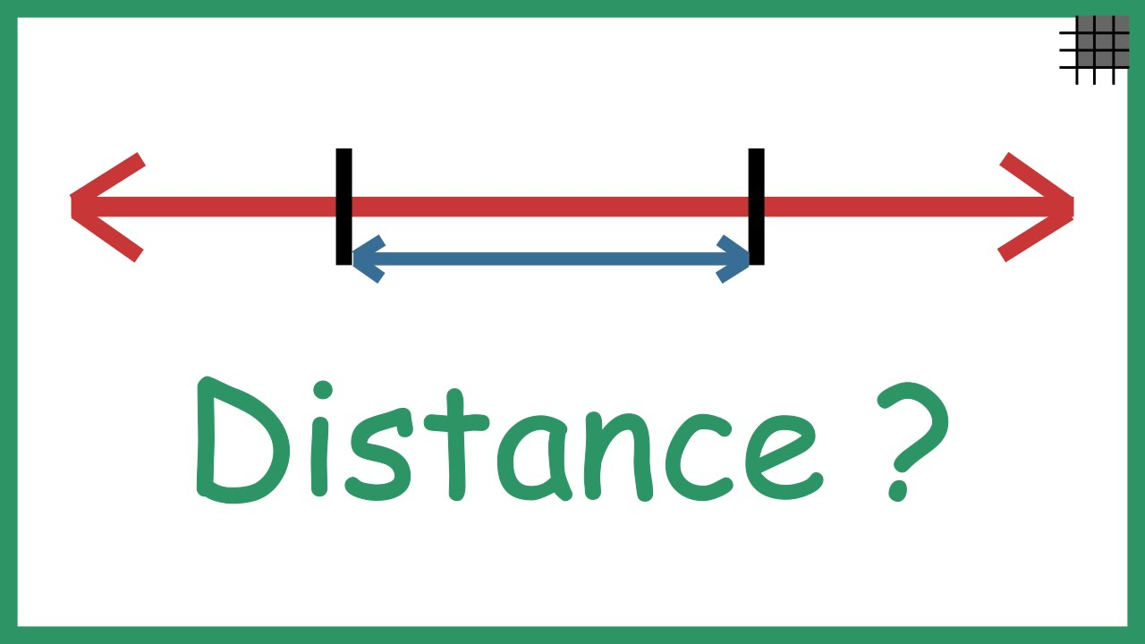
Distance

Slide 18
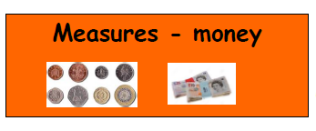
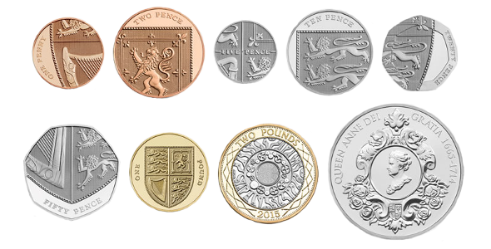

Money
How many 1p coins are in a 10p coin?

Slide 19
Here are some ideas to help you…

Slide 20
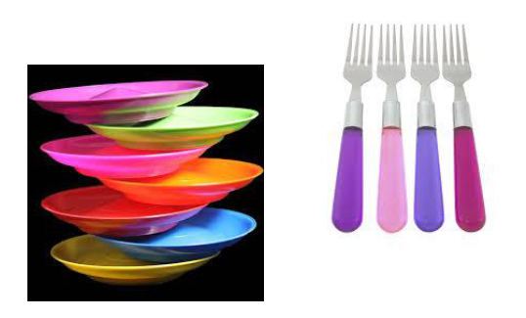
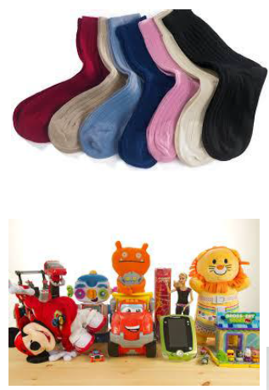
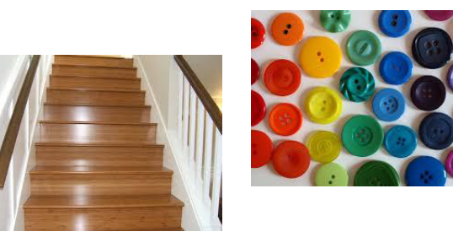
Counting

Slide 21
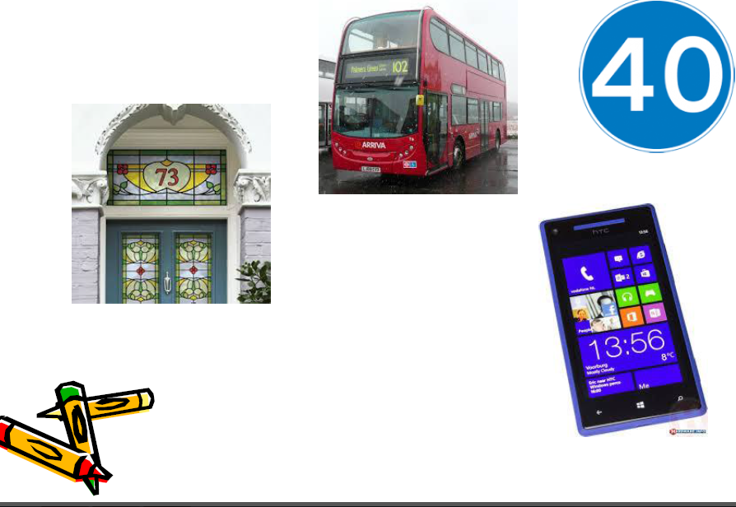
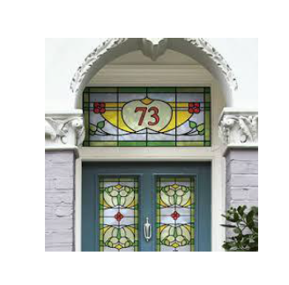
Looking for numbers

Slide 22
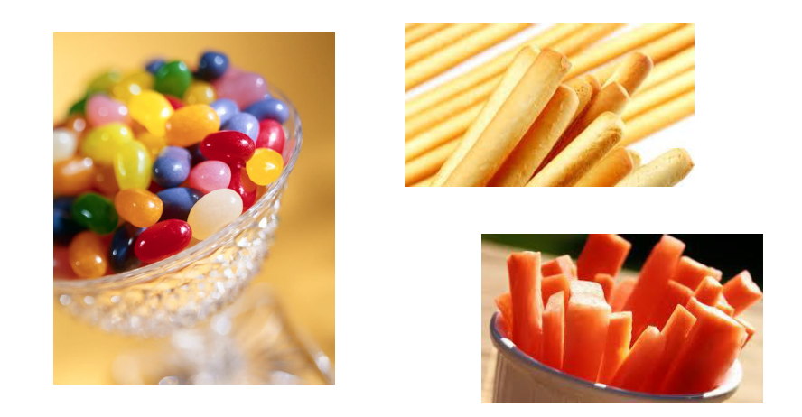
Sharing food

Slide 23
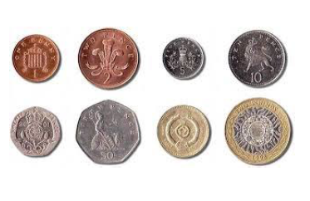
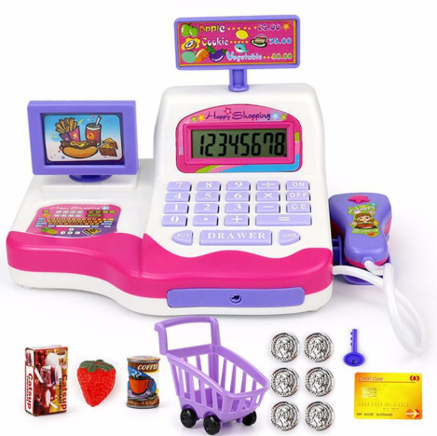
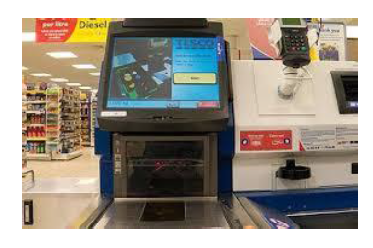
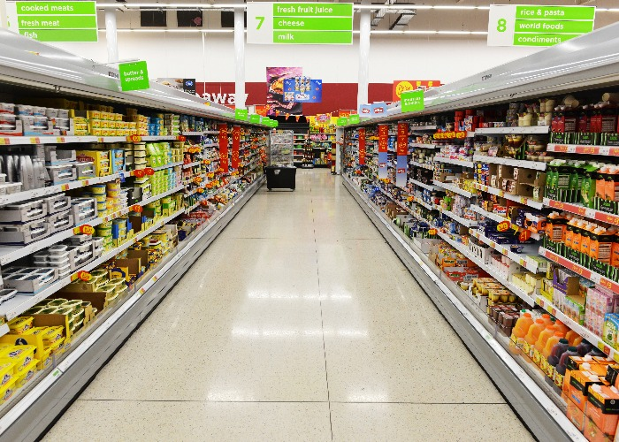
Money

Slide 24
Websites you can use at home
http://www.maths-games.org
www.ictgames.com
www.bbc.co.uk/schools
www.crickweb.co.uk
www.topmarks.co.uk
R Kavanagh 2019

