Slide 1

Glebe’s Secret Artist…
ART WEEK 2021

Slide 2
Can you guess the teacher who created these pieces of art…?

Slide 3
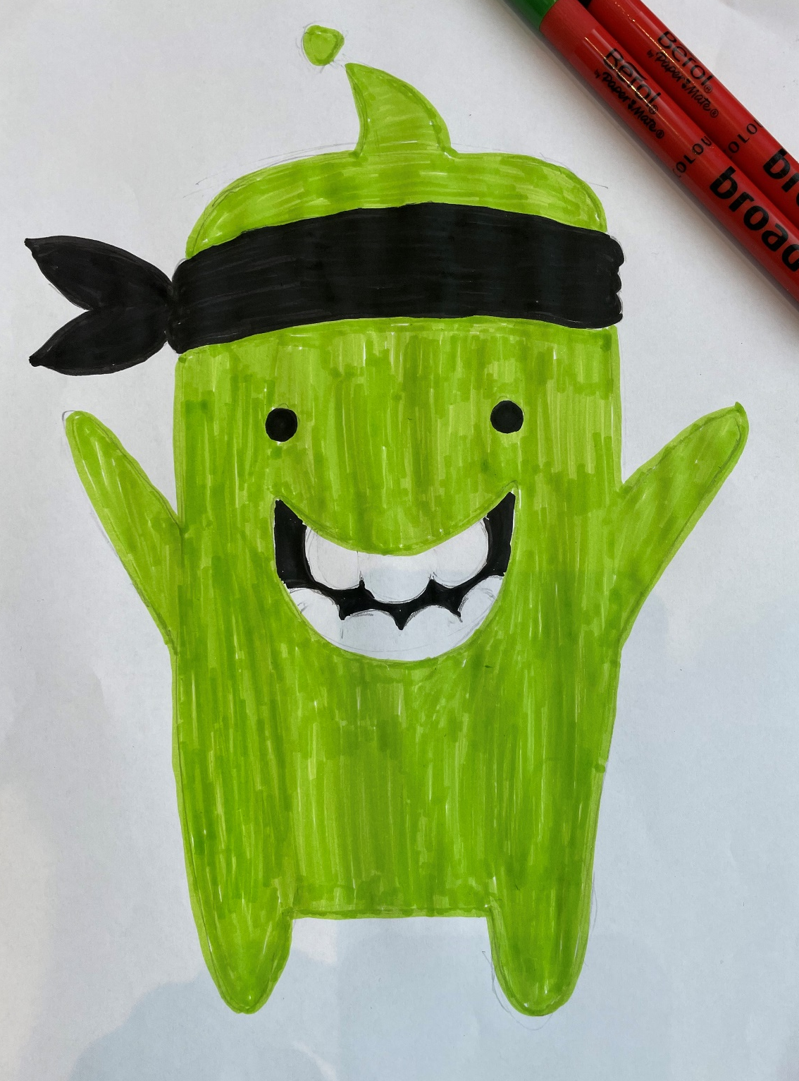
By Mrs sheehan

Slide 4
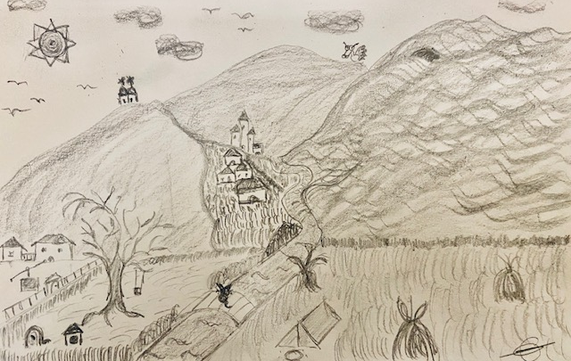
By Miss V

Slide 5
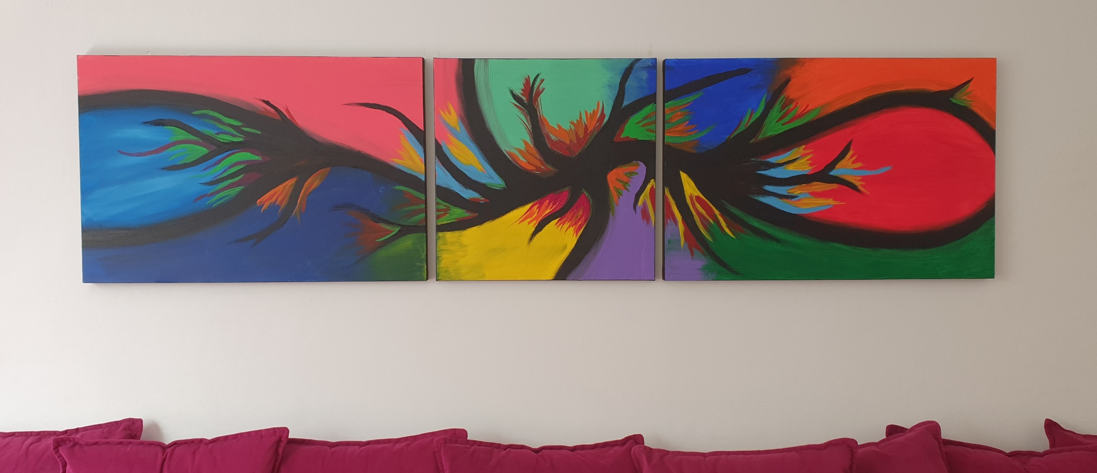
By mrs slaveva

Slide 6
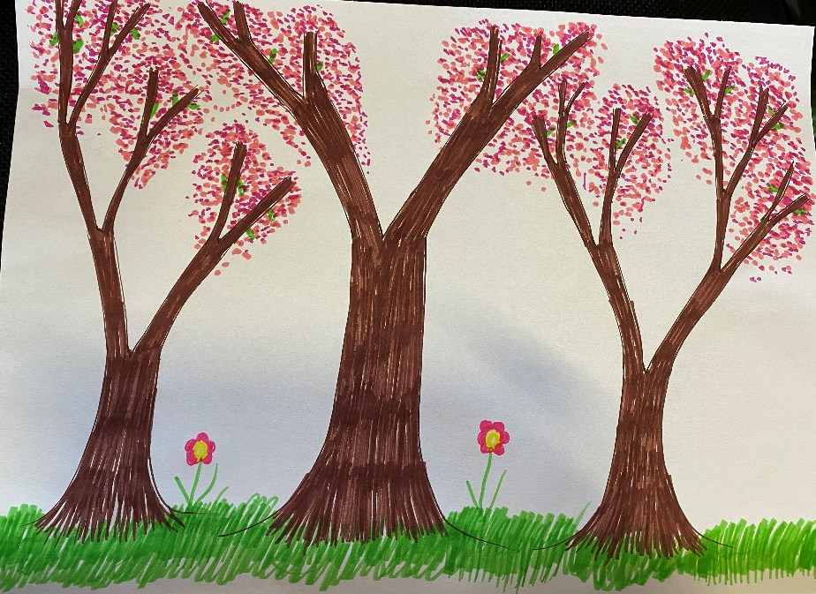
By mrs long yes, really!

Slide 7
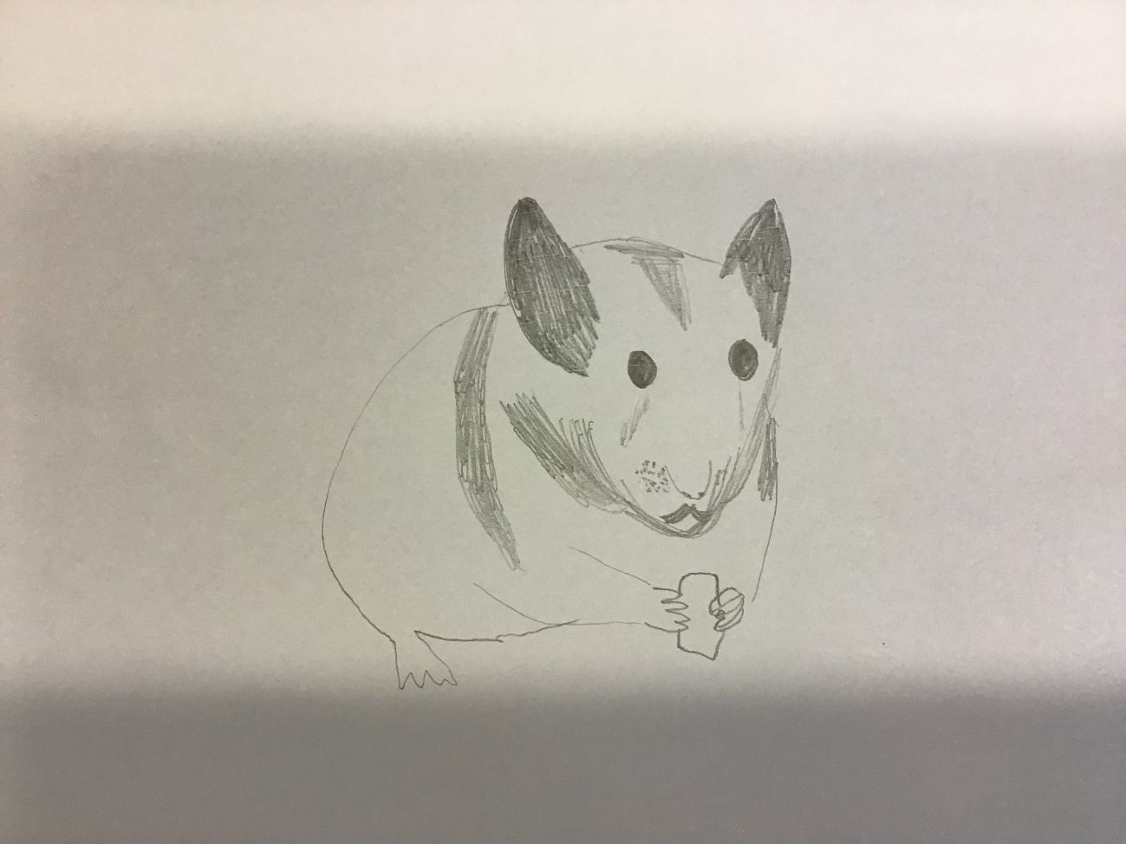
By mr curd

Slide 8
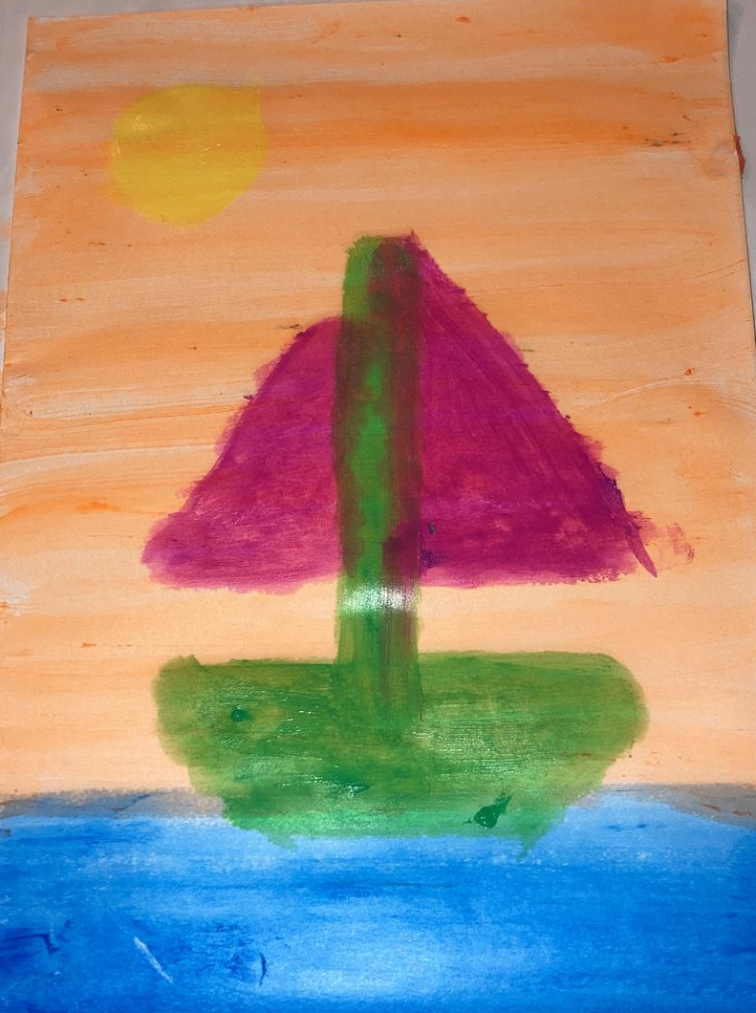
By mrs folland

Slide 9
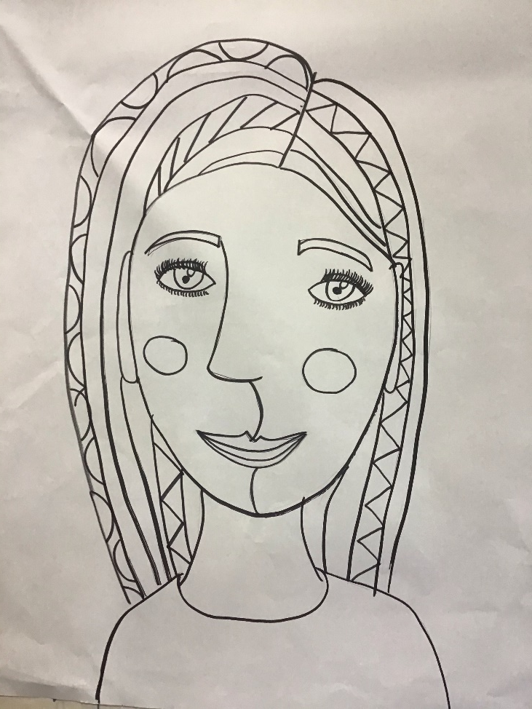
By miss gilbert

Slide 10
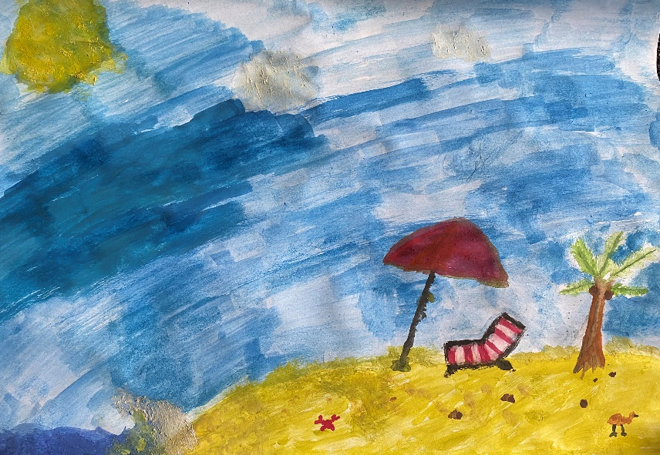
By mr meyrick

Slide 11
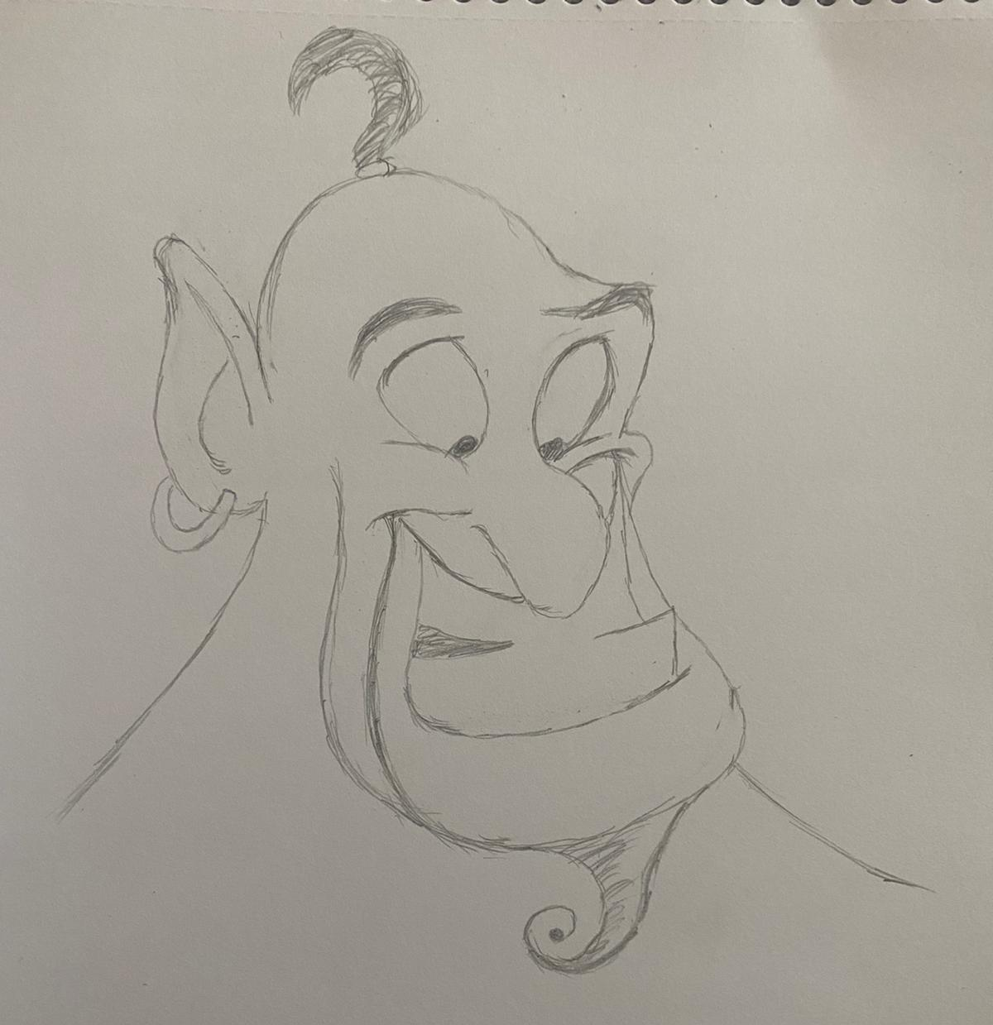
By miss rhodes

Slide 12
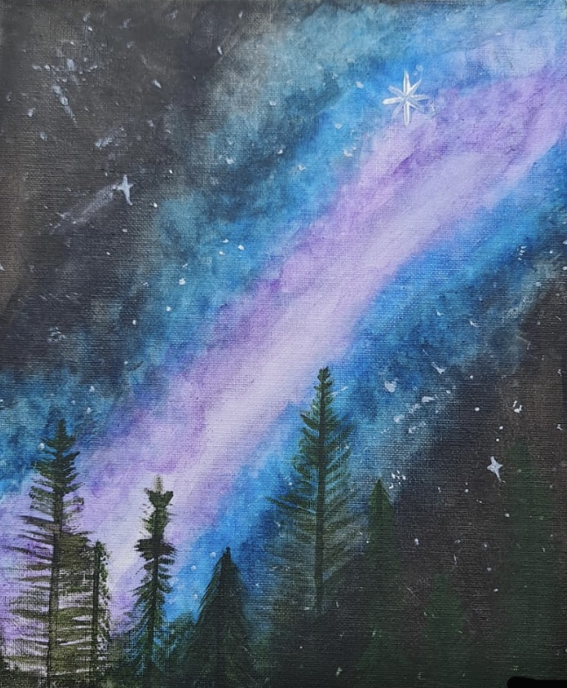
By miss connolly

Slide 13
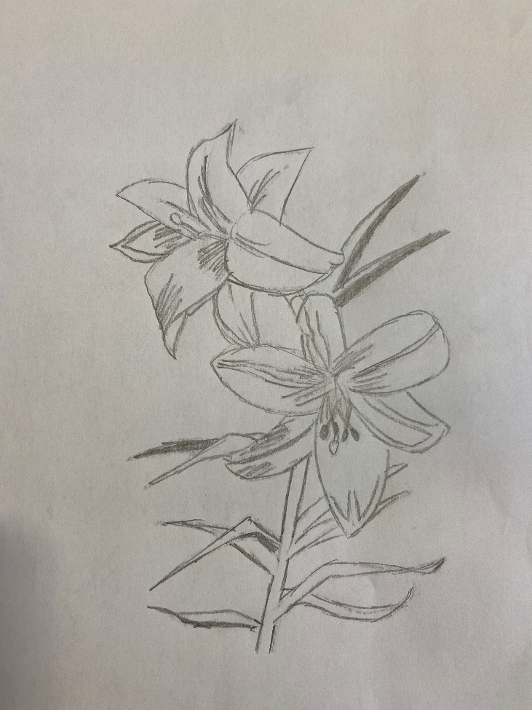
By ms akhter

Slide 14
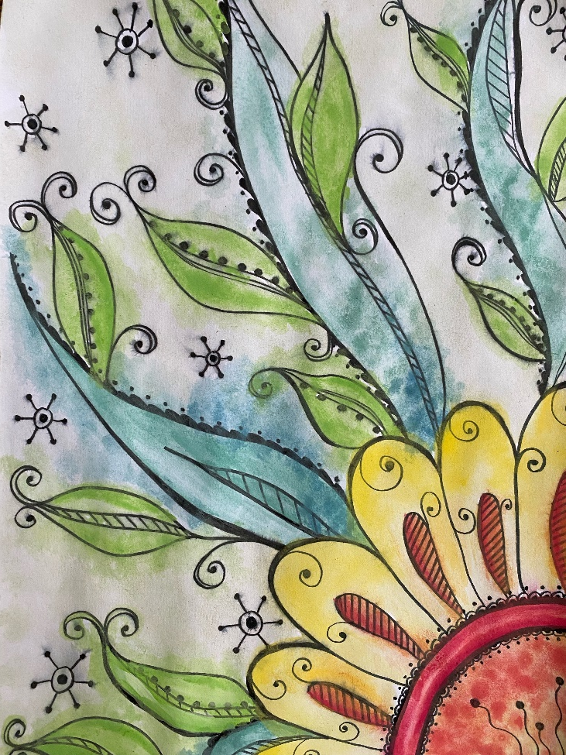
By mrs j

Slide 15
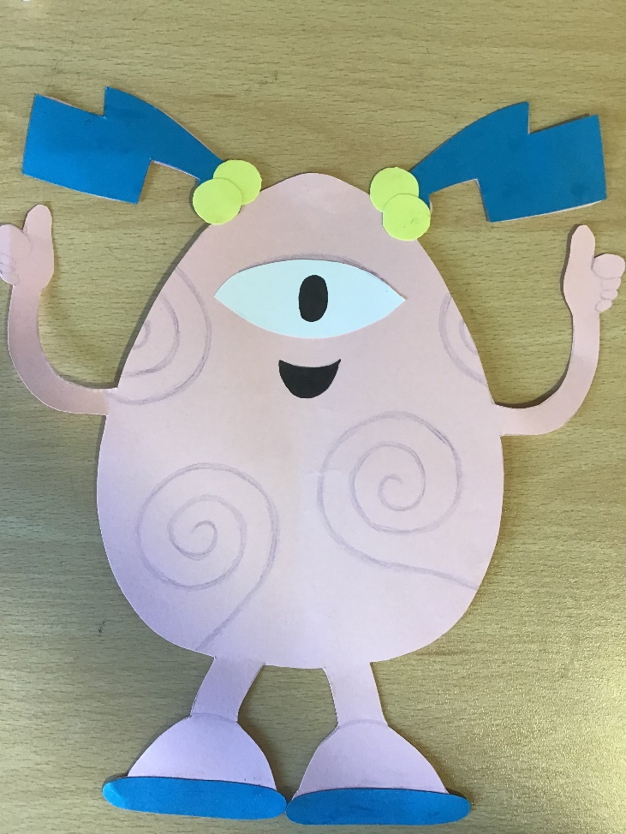
By miss lubbers

Slide 16
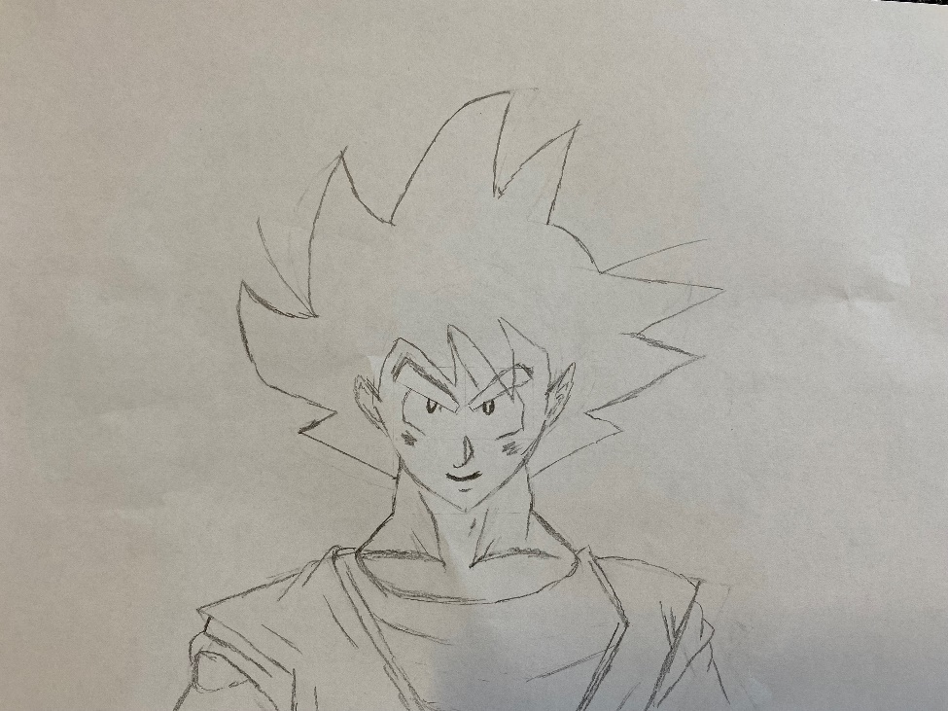
By mr v

Slide 17
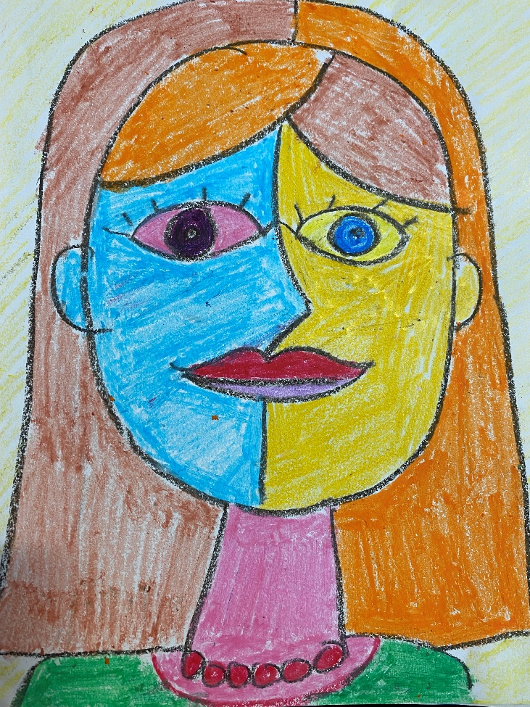
By mrs mountain

Slide 18
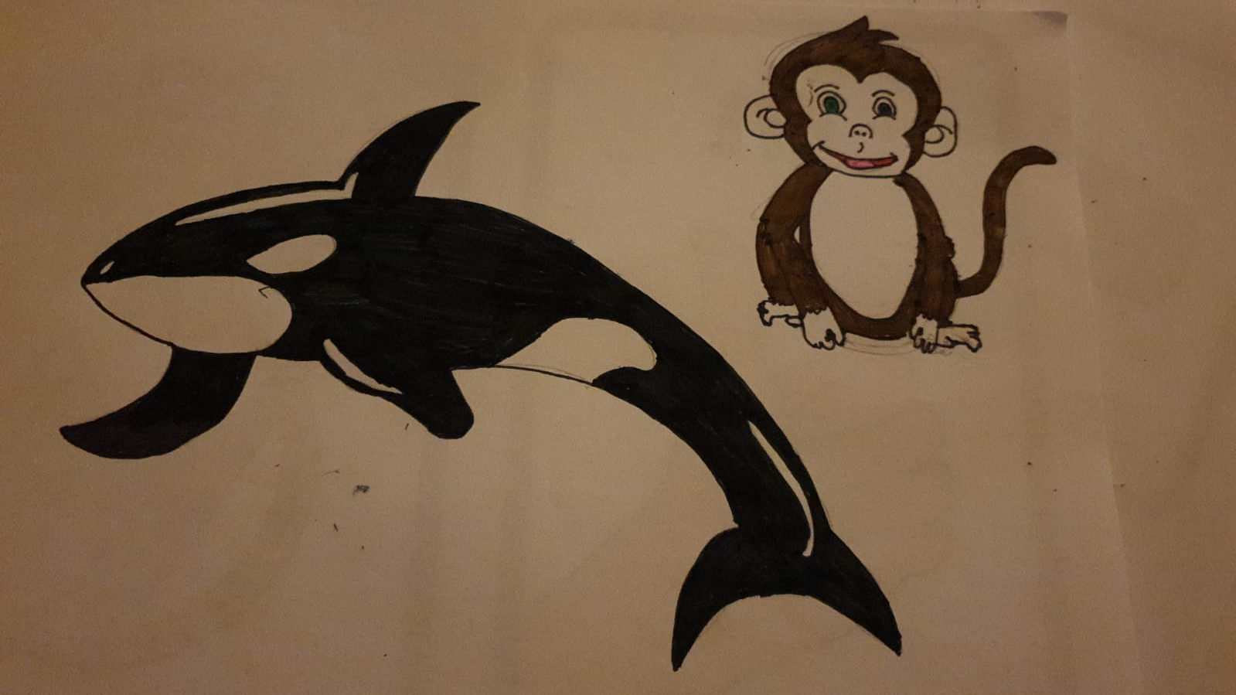
By miss griffiths

Slide 19

How many did you guess correctly?

Slide 20
Glebe’s Secret Artist…
ART WEEK 2021

