Slide 1
Zones of Regulation and information about external services.
Glebe School Parent Workshop Thursday 27th April

Slide 2
What external services do we have at Glebe and what do they do?
Speech and Language therapists – Hayley Smith and Misha Amin(SRP)
Specialist Speech and language therapist working in Deafness- Lousia Durnsford
Occupational therapist – Caroline Robinson
Technical Occupational therapist – Gemma Bignall
Physiotherapist – Michael Sharkey
Educational Psychologist - Ingrida Stankeviciene
Behaviour Support – Angela Canty
Vision impairment specialist teacher – Harry Cox
Teacher of the deaf for SEND advisory service - Jamie Anderton
Technology Consultant for Ewing foundation – Abul Hussain
SEN officer – Marta Mazik
Arts Co-ordinator for Equal Arts –Hannah Wood
Specialist SEN sports coach-Josh Thorne
Young carers – Luthea Makepeace
Telephone number for SALT, OT and Physio is ; 01895 488200

Slide 3

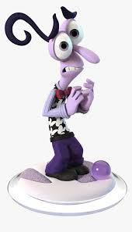


What is Zones of Regulation?
Zones of Regulation is an approach used to support the development of self-regulation in children.
All the different ways children feel and the states of alertness they experience are categorized into four coloured zones.
Children who are well regulated are able to be in the appropriate zone at the appropriate time.

Slide 4
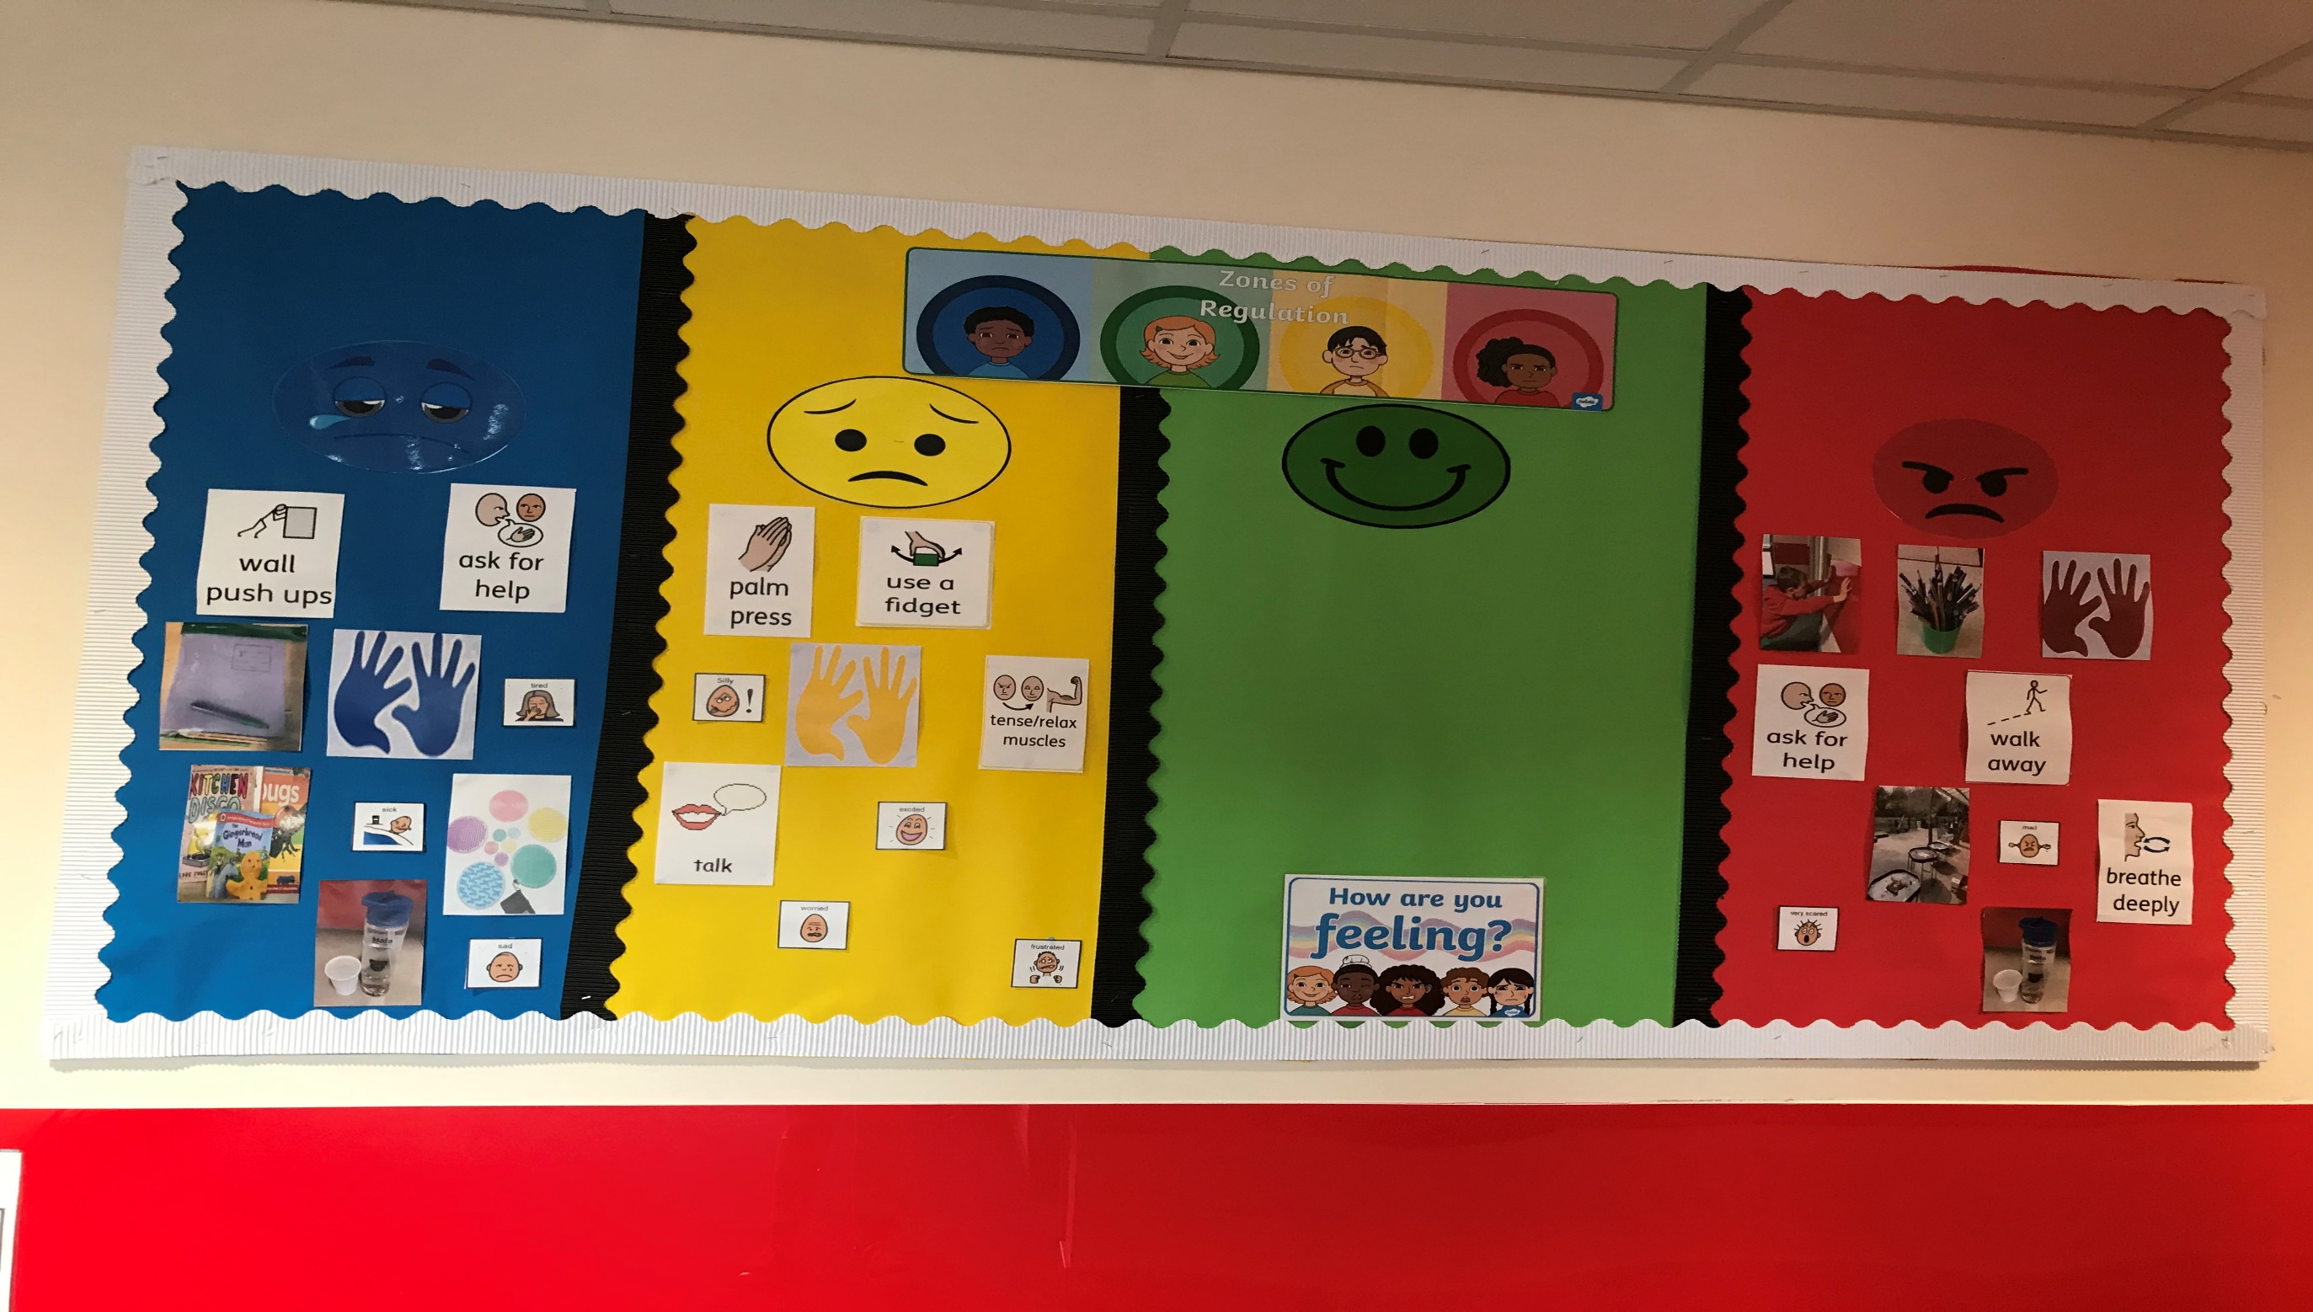

Slide 5
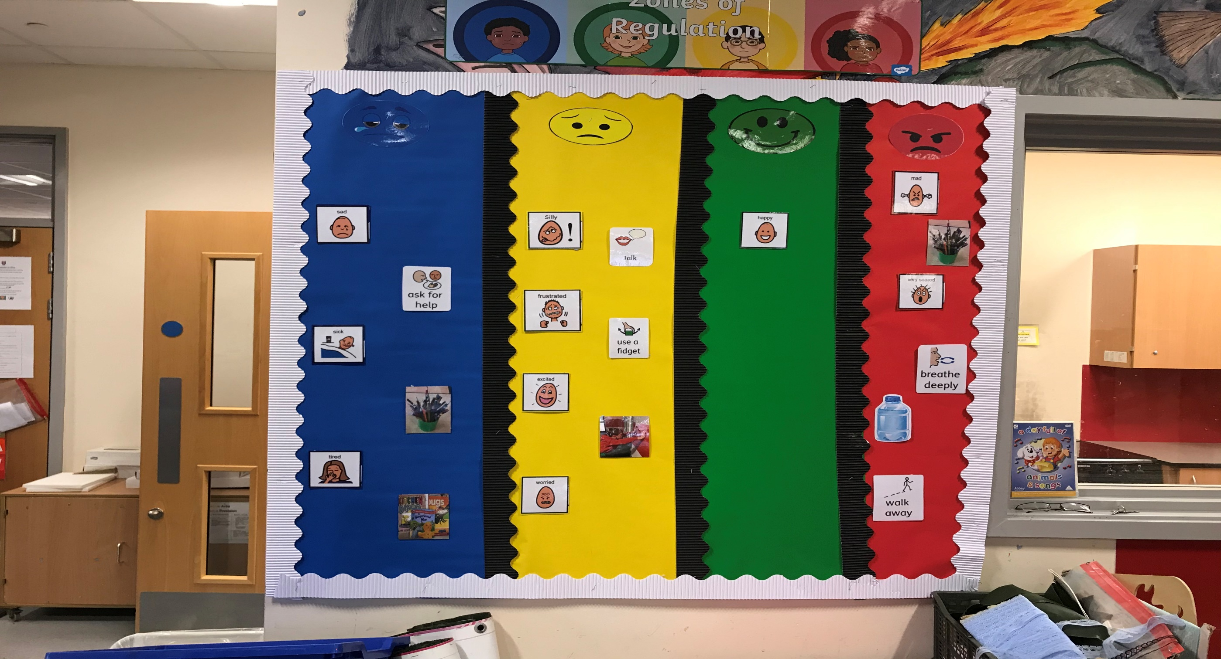

Slide 6
How do I introduce Zones of Regulation?
Identify your own feelings using Zones language in front of your child (e.g. “I’m frustrated, I am in the yellow zone”)
Talk about what tool you will use to be in the appropriate zone (e.g. “I’m going to go for a walk, I need to get to the green zone”)
Label what zone your child is in throughout the day (e.g. “you look sleepy, you are in the blue zone”)
Teach your child what Zones tools he can use to help him stay in the zone or move to a different zone (e.g. “it’s time for bed, let’s read a book together in the rocking chair. We’re in the blue zone”)

