Slide 1
Understanding and Using Language .
Glebe School Parent Workshop Thursday 7th March 2024

Slide 2

Aims of our workshop
Strategies to use to develop your child’s language.
Activities you can do to focus on key skills in a fun and playful way.

Slide 3
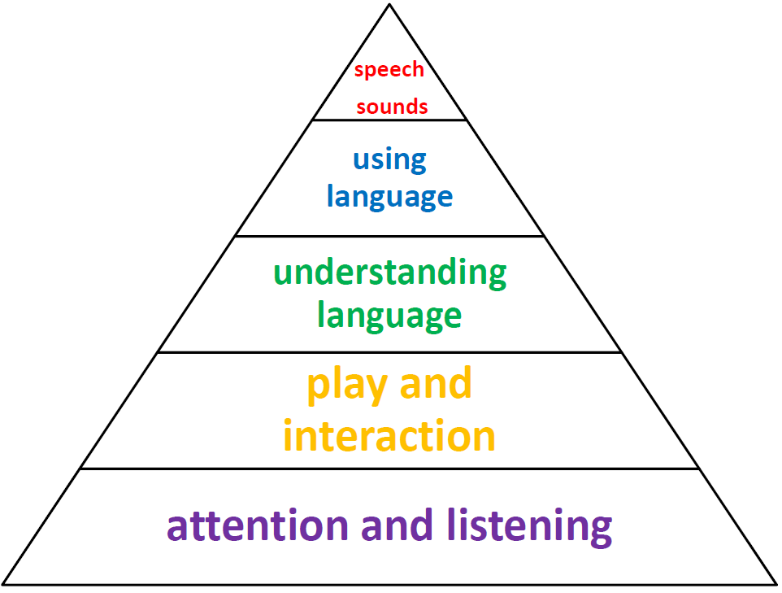
What is communication development?
Children need to understand words before they can use them in speech.

Slide 4

How can I support my child if I do not speak very good English?
Speak in the language you feel most comfortable in.
Whatever language you are speaking give a correct model of it.
Keep your language simple.
Use visuals eg gestures, objects or pictures.

Slide 5


Language depends on memory skills.
3 types of memory – short term memory, working memory and long term memory.
Short term
Children may struggle with directions, instructions and need visual clues or instructions written down.
Working memory
Children may have poor academic progress, be very distracted, fail to complete tasks and a low self esteem.
Long term memory
Children will struggle to learn new concepts despite repeated information given and visual being provided.

Slide 6
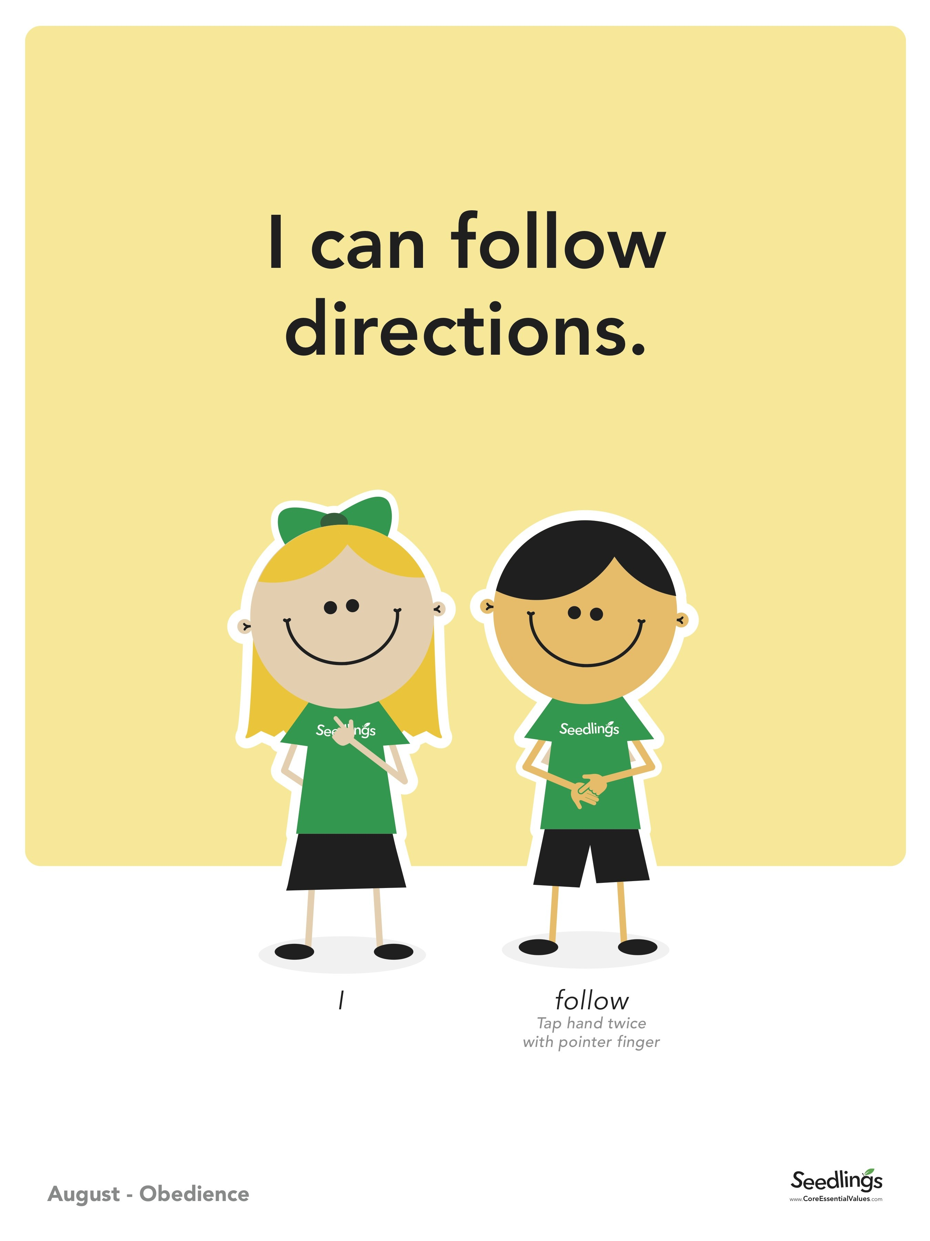
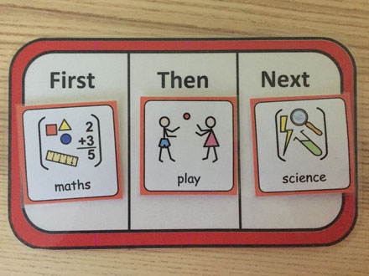
Strategies to help with memory difficulties.
Get your child’s attention first.
Pause between sentences.
Repeat instructions and get the child to repeat them back to you.
Short and simple instructions no more than 1 or 2 at a time.
Use visuals as a reminder.

Slide 7
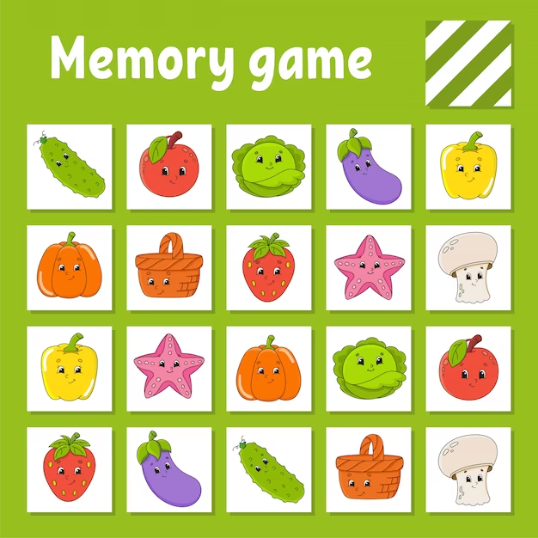
Activities to help with memory difficulties.
I went shopping and I bought …..
Simon says…..
When out shopping ask your child to get 2 apples and a banana
Role play taking telephone messages
Kim’s game (removal of items)
Matching games

Slide 8

Difficulties understanding language
They will struggle to understand the meaning of words
They will struggle to understand how sentences are formed eg I go house
They will struggle to form grammatically correct sentences eg I wented to the park today
They will struggle when questioned and muddle up question words eg Where is the girl? She has a dog.
They will struggle to re-tell a story or event – this can lead them to be completely misunderstood.

Slide 9

Strategies to help the understanding of language.
Ensure you have their full attention – call their name and make sure they are looking at you.
Use short and simple sentences.
Use visuals as much as possible – gestures, objects and actions.
Use simple questions.
Use rule of 5 – 4 comments and 1 question.
Talk about what interests them.
Ask open questions.

Slide 10
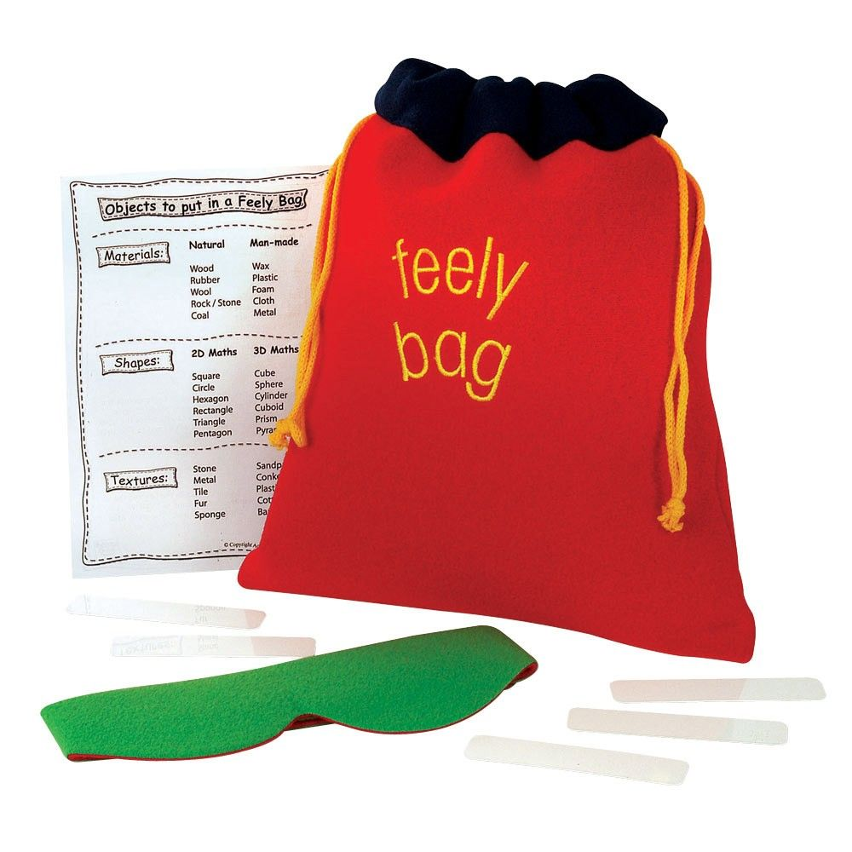

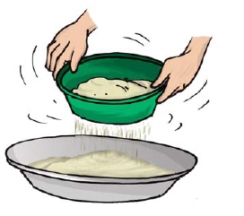
Strategies to support poor vocabulary
Use visuals and objects as much as possible
Use everyday situations to teach vocabulary – do it
Repeat the vocabulary and actions
Find out what topics are being taught in class and introduce the vocabulary before hand so it is not new to the child
Make a feely bag with topic objects
Play the alphabet game
Play the topic game

Slide 11

How often should I put all these strategies into place?
As much as possible!
As part of your day to day routine.
Give your child some individual attention per day (even if it is 5 minutes).
Play/watch with hem – even if it is screen time, you can be communicating and commenting on their game or TV program.

Slide 12
Cits information
(children's integrated therapy service)
01895 488200 - if under SALT ask for our therapist (Hayley Smith)
Citsadmin.cnwl@nhs.net
Hillingdon talks website Hillingdon Talks, Moves, Plays: Children’s Integrated Therapy Service (CITS) (cnwl.nhs.uk)

