Slide 1
How to help your child with transition and moving to the next year group.
Glebe School Parent Workshop Monday 26th June 2023

Slide 2
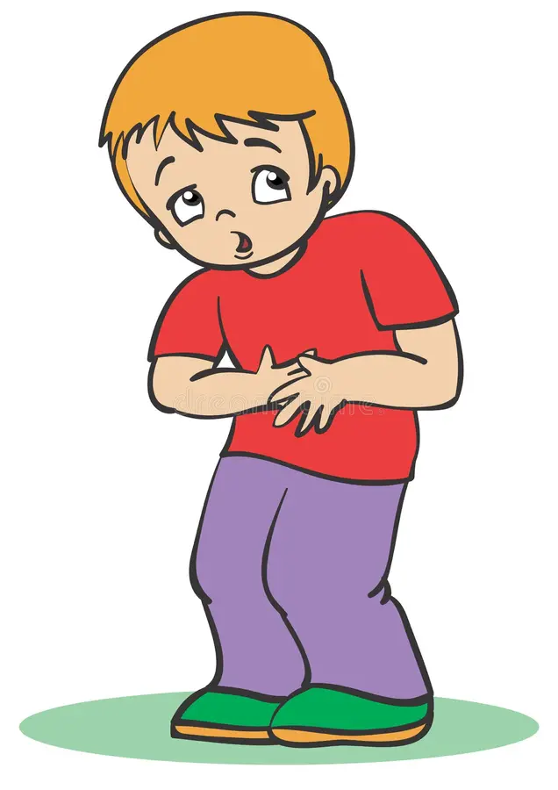
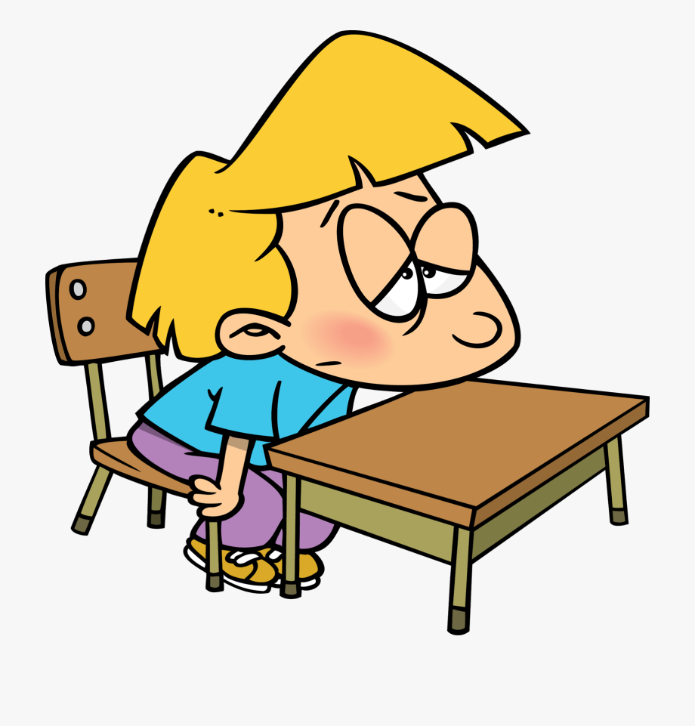


How might I know that my child is struggling with transition to their class and teacher?
Your child might display the following symptoms:
Difficulty getting to sleep or a disturbed sleep and extreme tiredness.
Complaining of unexplained stomach aches/headaches
Change in heart rate or becoming breathless
Unexplained tearfulness
Becoming overexcited and displaying a range of negative behaviours

Slide 3
Why might my child be anxious about changing classes?
All children are different and will react in different ways
They may be worried about being in a different part of the school building “ will I get lost?”
They might be worried about their new teacher “ will my new teacher tell me off for getting my spellings wrong?”
They might be worried about a change in routine or timings of the day “ What if I am hungry before it is lunchtime?” or “ When is assembly?”
They might be worried about you not finding them at pick up “What is my grown up can’t find me in my new classroom?”

Slide 4
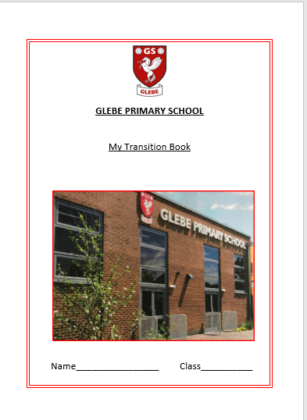
What do we do at Glebe to help our pupils with transition?
They visit their new teacher/LSA and classroom on 4th July and spend an hour getting to know their new staff.
We create transition booklets for any pupil who we feel may require extra support throughout this process. This includes photographs and names of all staff they will come into contact with in their classroom, photographs of their new classroom and the entrance they will use.
We arrange for impromptu visits to new class teachers after the transition day to develop the new relationship with the teacher.

Slide 5
How can I help my child with transition to their new class or school?
Encourage your child to tell you what they are worried about for next year – ask them to tell you 1 exciting thing about moving to the next year.
As a family talk about their new adventure – “oh look there’s your new classroom – how exciting you will have Mr …… or Mrs/Miss …….. Look how happy they look to be greeting their class” or “ How exciting it is that you are now old enough to go into school on your own – I’m so proud of you”
Over the summer holidays go over their transition book several times so are expecting the change to come.
Reassure your child that you know where they need to be collected from and ensure whoever is responsible to collect them or drop them off knows where this is.
Read some stories about change and transition.

Slide 6




Some examples of books to share with your children.

