Slide 1
How to manage challenging behaviour effectively?
Glebe School Parent Workshop Thursday 16th November 2023

Slide 2
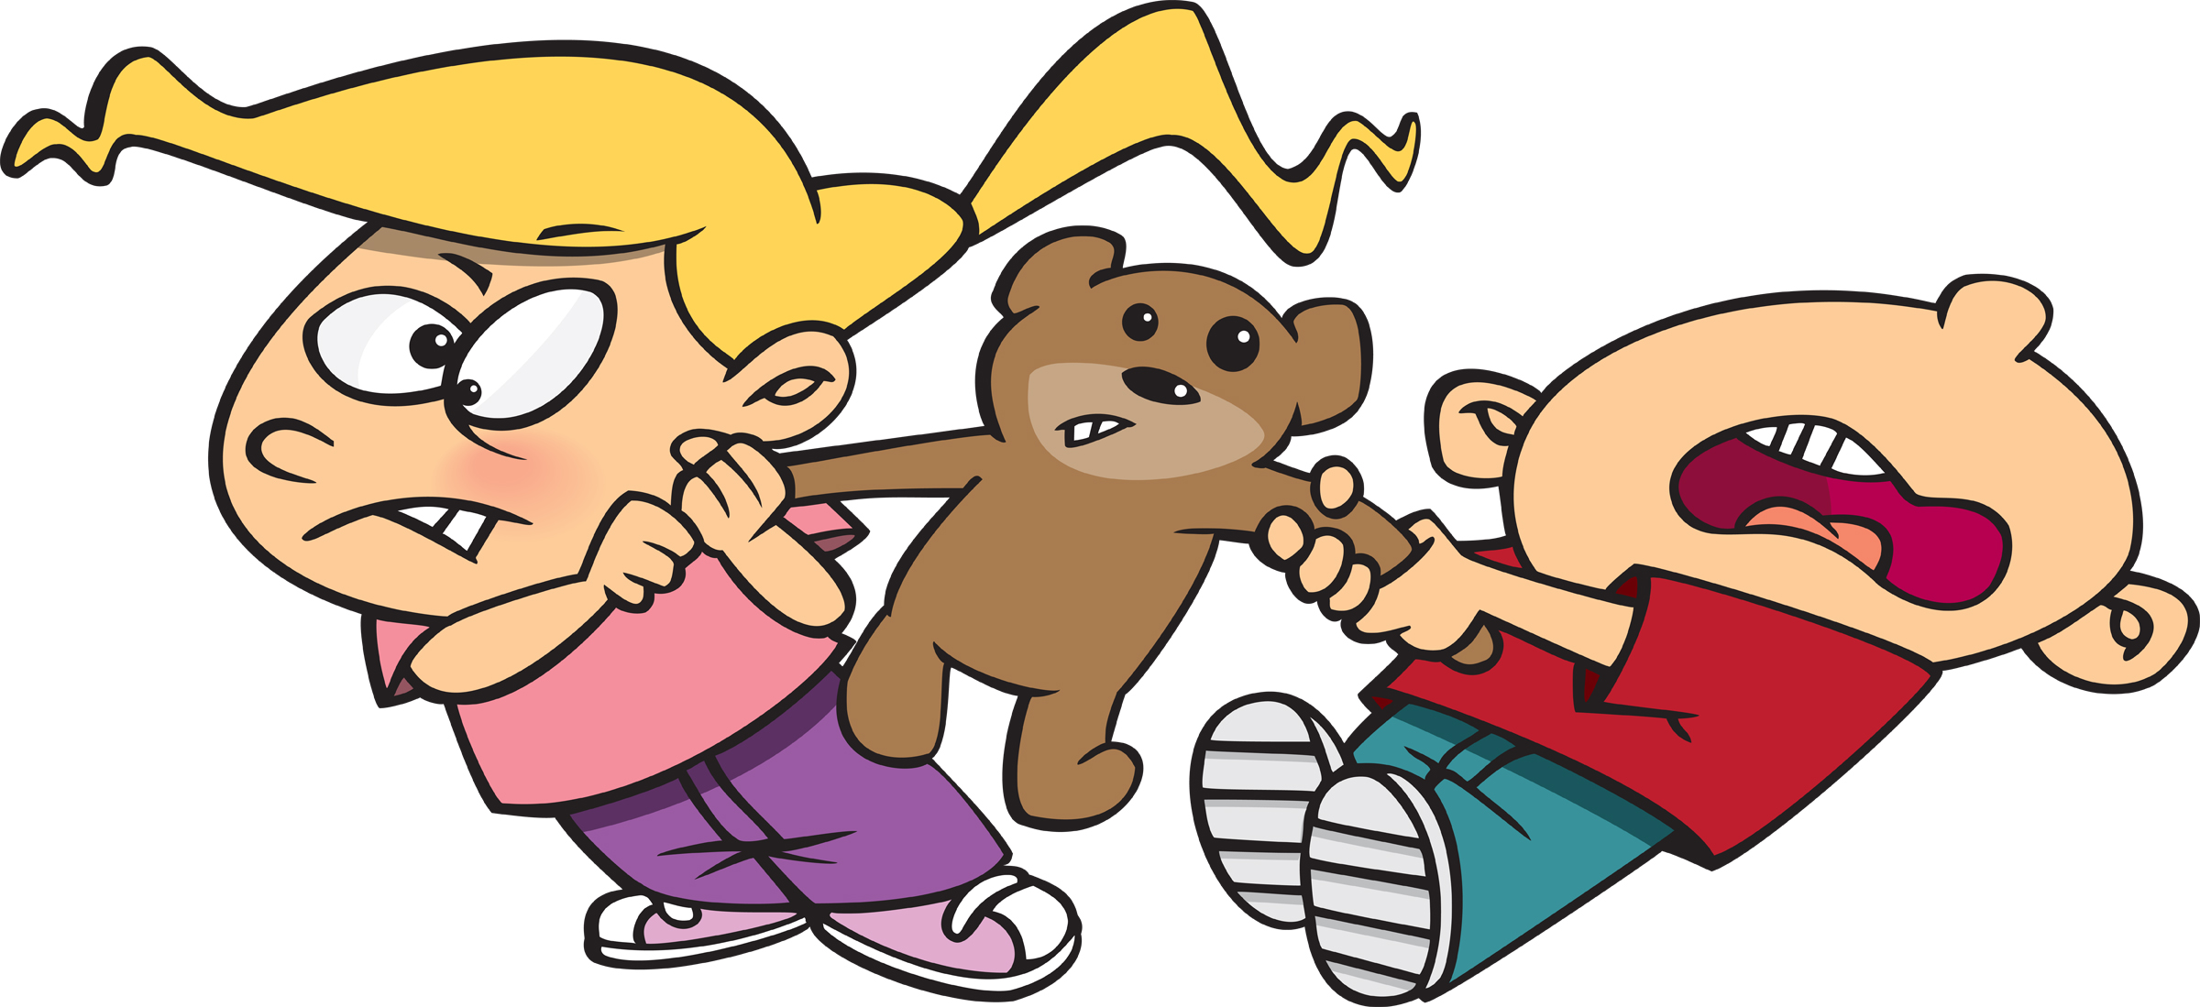
What can challenging behaviour look like?
Aggression
Destructiveness
Rudeness
Disruptiveness
Self harm
Unsafe behaviours (eg running away, climbing & not following instructions)
REMEMBER THAT ALL CHILDREN NEED TO LEARN WHAT ACCEPTABLE BEHAVIOUR LOOKS LIKE

Slide 3
What can cause challenging behaviour?
Children can become easily overwhelmed by changes in situation eg bereavement, separation of parents or siblings leaving home, new baby within family, friendship issues, house move and relocation.
Children who have high levels of anxiety and are unable to verbalise what is wrong – anxiety may be caused by previous life experiences or medical reasons. Often anxiety will be masked and seen as challenging behaviour.
Children with neurodiversity eg ASD/ADHD.
Children with complex medical conditions.
Children with underlying learning difficulties (which may or may not have been diagnosed) they often have very low self esteem and will become very frustrated at not being able to understand or follow what is being taught in class resulting in outbursts at home which is their ‘safe place’.
Lack of routine within the family home – does the child know who is picking them up, taking them to their activities and putting them to bed!
Lack of clear and consistent boundaries from care-givers.
Lack of attention – so will display challenging behaviour to gain any attention from care givers.

Slide 4

How can you support your child with challenging behaviour?
Stay calm, use calm voice and don’t get into an ‘argument’ with your child.
Explain to your child that it is their BEHAVIOUR that you are not accepting not them. ‘I love you but I don’t like that you have broken your brother’s toy’
Use RESTORATIVE JUSTICE with your child after challenging behaviour (this must be once they are calm enough to talk about the event).
‘You’ve broken your brother’s toy – how do you think he feels about that? – what could you do to put this right?’
Once your child is calm use the Zones of Regulation to work out what they COULD have done if they were angry/frustrated. Use the Zones of Regulation vocabulary at all times as a family
‘I’m feeling really angry that you have not taken care of your new toys- I am in the Red Zone – I need to go for a walk to calm down.’

Slide 5


Rather than use punishment on your child use motivational reward eg
‘If you can tell me your angry rather than hurting your sister you can have a marble for your jar and you are closer to your reward’
Use distraction techniques
‘I need your help to find my glasses as you are such a good finder – what would I do without you’
Try to work out any triggers or patterns in behaviour and prepare for this eg is it every bedtime, hair brushing, dinner time, using the xbox (refusing to come off it), going to the supermarket or being told NO! Prepare your child in advance that the event is going to happen or that their time limit is near to completion to give them time get used to what is expected.
Have firm boundaries of expectations and consequences that you make as a family – write them down (or use pictures) and with older children ask them to sign their agreement. This can be referred to when challenging behaviour starts and consequences put in place.
Finally BE CONSISTENT.

Slide 6
Any questions?

