Slide 1
How can parents help their child with their learning?
Glebe School Parent Workshop Tuesday 26th September

Slide 2
There are several things that parents can do to support their child with their learning.
We understand that most children are ‘reluctant’ learners at home and will find it challenging to do work at home.
Children work incredibly hard during the school day and often are exhausted when they get home; so be realistic about the amount of work you expect from them.

Slide 3
Find a routine that works for your child and family.
Most children thrive on routine and like to know what is happening and when.
Create a timetable for the week or weekend building in time for home learning around activities they enjoy.
Set a realistic time limit for home learning – break it into smaller chunks.
Praise the effort of your child not the outcome – some children will find learning harder than others and will lose confidence in their ability if they are ‘told off’ for not getting it right first time.

Slide 4
Try to teach your child that failure is a stepping stone to success.
Everybody needs to learn how to do something by making mistakes – mistakes are good!
Acknowledge mistakes and model how you learn by your mistakes (make it up if you to!)
Play games like chess – this will teach resilience and can be replayed to improve skills.
Don’t overpraise and be specific eg don’t say
“That was good” say
“The way you wrote your letter y is correct - well done”

Slide 5
Allow your child to opportunity to practice the things they enjoy and are good at!
As professionals and parents it is too easy to make the children practice only what they are not very good at! This creates a negative feeling towards learning, as it is always difficult. Let them practise the things they are good at as well, this will develop more confidence and a feeling of achievement.
Share their passion for subjects they are good at and value their importance – even if it is not reading, writing or maths!

Slide 6

Make all subjects relevant to your child and a part of their every day experiences.
Learning is not and should not be simply writing on worksheet or exercise book.
Learning is around us at all times – when going on holiday get an atlas or map and with your child find where you are going, look at the seas or rivers you will cross getting there and look at the roads you will drive along – this is real life geography or when walking down the road look at the door numbers and get your child to predict which one will come next – this is counting in twos and is real life maths. Children do not see this as ‘learning’ but these are often very important ‘skills’ which we teach at school.
Get cooking with your child – measuring, weighing, adding, reading recipes and listening to instructions – all are skills they need for learning.

Slide 7
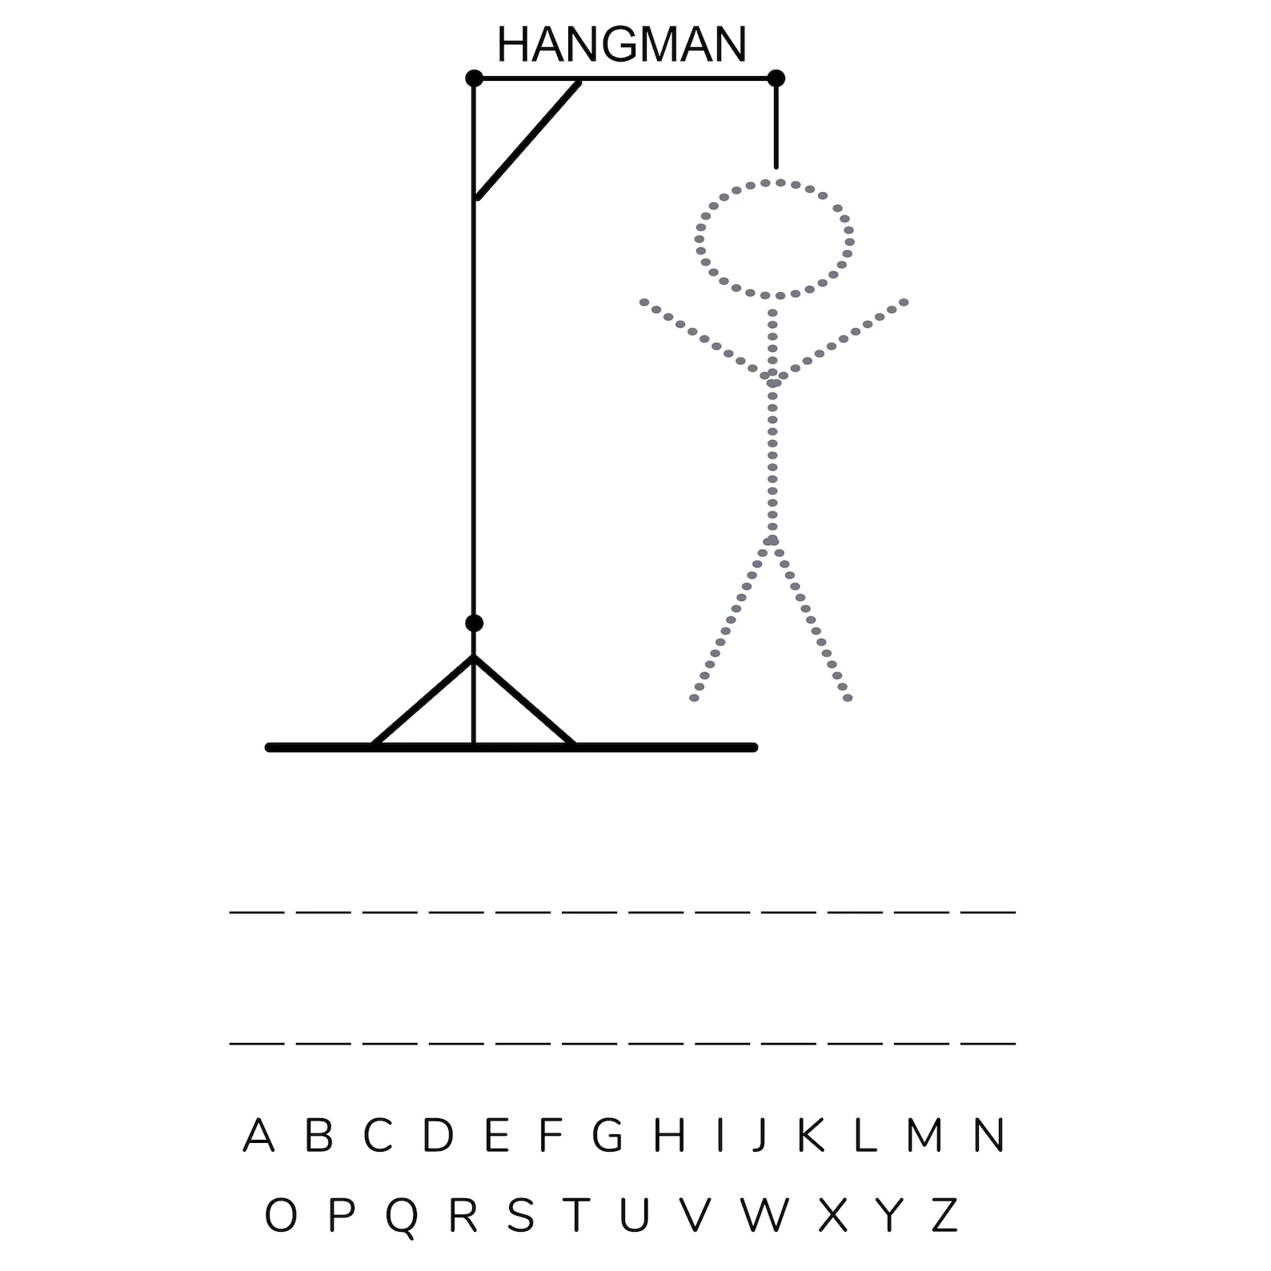
Involve as many games in your child’s learning - gamification
This is the action of turning something into a game to improve engagement – games like hangman/scrabble can help to learn spellings and vocabulary.

Slide 8

Motivate by consequence rather than punishment.
EG “ when you've finished your work you can watch your favourite cartoon” rather than “if you don’t do your work I won’t let you watch your favourite cartoon” – turns a negative action into a positive one.
Motivation by punishment can often lead to deception by the child as they will like to get out of doing something they don’t want to and teach the child that threats are an acceptable way to problem solve!

Slide 9
Don’t compare your child with others
Value the effort that your child makes not the outcome; don’t compare siblings or peers – each human is unique and has their own learning style and ability.
Look at the progress your child is making – small steps are very valuable!

