Slide 1
Building and maintaining relationships.
Glebe School Parent Workshop Monday 20th May

Slide 2
What can you do to support your child with building and maintaining relationships?
Children need to be taught and modelled how to develop relationships with others.
Empathy – model kindness and respect towards others and try not to ignore sibling conflict
Curiosity in others – talk about what you have done that day and ask your child what they have done
Communication skills – turn off devices and talk!
Co-operation – play games and do chores together working in teams
Apologise – teach the skill of resolving conflict
Compromise – teach the skill of compromise – parents don’t always need to get their own way!

Slide 3
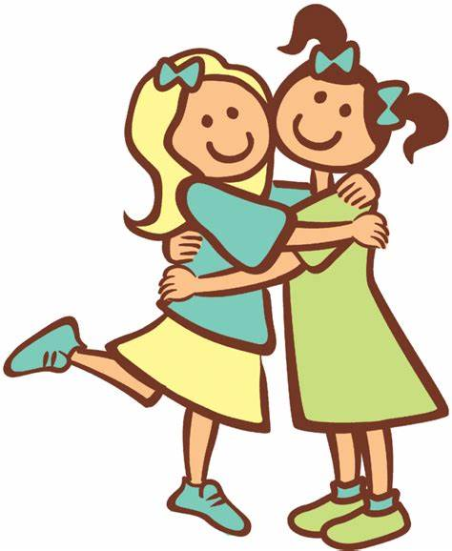
Set up play dates with peers – inside activities and outside activities, keep an eye on them but don’t hover, listen from a distance and intervene as necessary to model resolving conflict
Role play social interactions eg buying things in shops, going to doctors to practise having conversations and initiating conversation

Slide 4
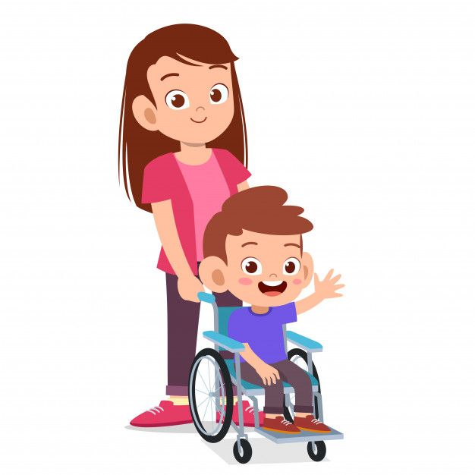
Why are relationships often harder for children with SEND?
They may have slower processing speeds which lead to a delayed response to social situations.
They may have difficulty listening to and following conversations.
They may have challenging behaviour and react to conflict negatively.
If a child has a 1:1 adult support the other pupils may see them as different and avoid friendships.

