Slide 1
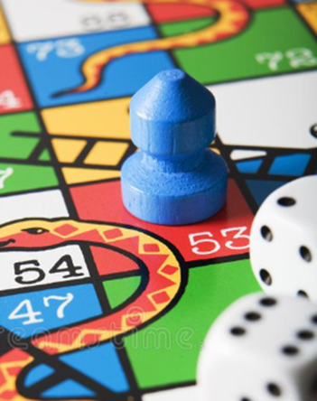

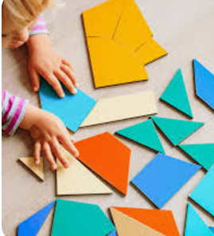

Playing games that involve taking turns and sharing is a great way to help your child develop positive friendships at nursery.
Miss Wands’ Top Tips!
Set simple tasks for your child to complete. We expect children to assist with tasks such as tidying up toys or handing out plates for snack time.
Giving your child some child friendly tasks at home can really help with this, it is also a great way to build up their confidence and independence.
Please ensure your child can independently dress themselves. We promote free flow between indoor and outdoor learning. Therefore throughout the day children will be required to put on their coats and swap between their outdoor wellies and indoor shoes.
Set aside time to share books with your child. At Glebe we are passionate about nurturing a love for reading and ensure our learning environment allows children to access a wealth of literature.
Support your child’s early numeracy skills by recognising shapes and numbers around the house and in your local area.
Nursery rhymes and counting songs are a great way to introduce the basics.

